Slide 1

Brazilian E-Commerce Public Dataset by Olist

Slide 2

This dataset was generously provided by Olist, the largest department store in Brazilian marketplaces. Olist connects small businesses from all over Brazil to channels without hassle and with a single contract. Those merchants are able to sell their products through the Olist Store and ship them directly to the customers using Olist logistics partners. See more on our website: www.olist.com
After a customer purchases the product from Olist Store a seller gets notified to fulfill that order. Once the customer receives the product, or the estimated delivery date is due, the customer gets a satisfaction survey by email where he can give a note for the purchase experience and write down some comments.
An order might have multiple items.
Each item might be fulfilled by a distinct seller.
All text identifying stores and partners where replaced by the names of Game of Thrones great houses.
data description :
Welcome! This is a Brazilian ecommerce public dataset of orders made at Olist Store. The dataset has information of 100k orders from 2016 to 2018 made at multiple marketplaces in Brazil. Its features allows viewing an order from multiple dimensions: from order status, price, payment and freight performance to customer location, product attributes and finally reviews written by customers. We also released a geolocation dataset that relates Brazilian zip codes to lat/lng coordinates.
This is real commercial data, it has been anonymised, and references to the companies and partners in the review text have been replaced with the names of Game of Thrones great houses.

Slide 3



Motivation
Very rich data and a lot of insights and Infinities of ideas can extract from this data

Slide 4


Define the problems of business
Detect any abnormalities in the data
Identify the weak points of business
Asking effective business questions and answering on it
Extract useful insights from the data
Showing the trends and KPIs of the business
Make recommendations the improve the business
Objectives
Define the problems of business
Detect any abnormalities in the data
Identify the weak points of business
Asking effective business questions and answering on it
Extract useful insights from the data
Showing the trends and KPIs of the business
Make recommendations the improve the business

Slide 5
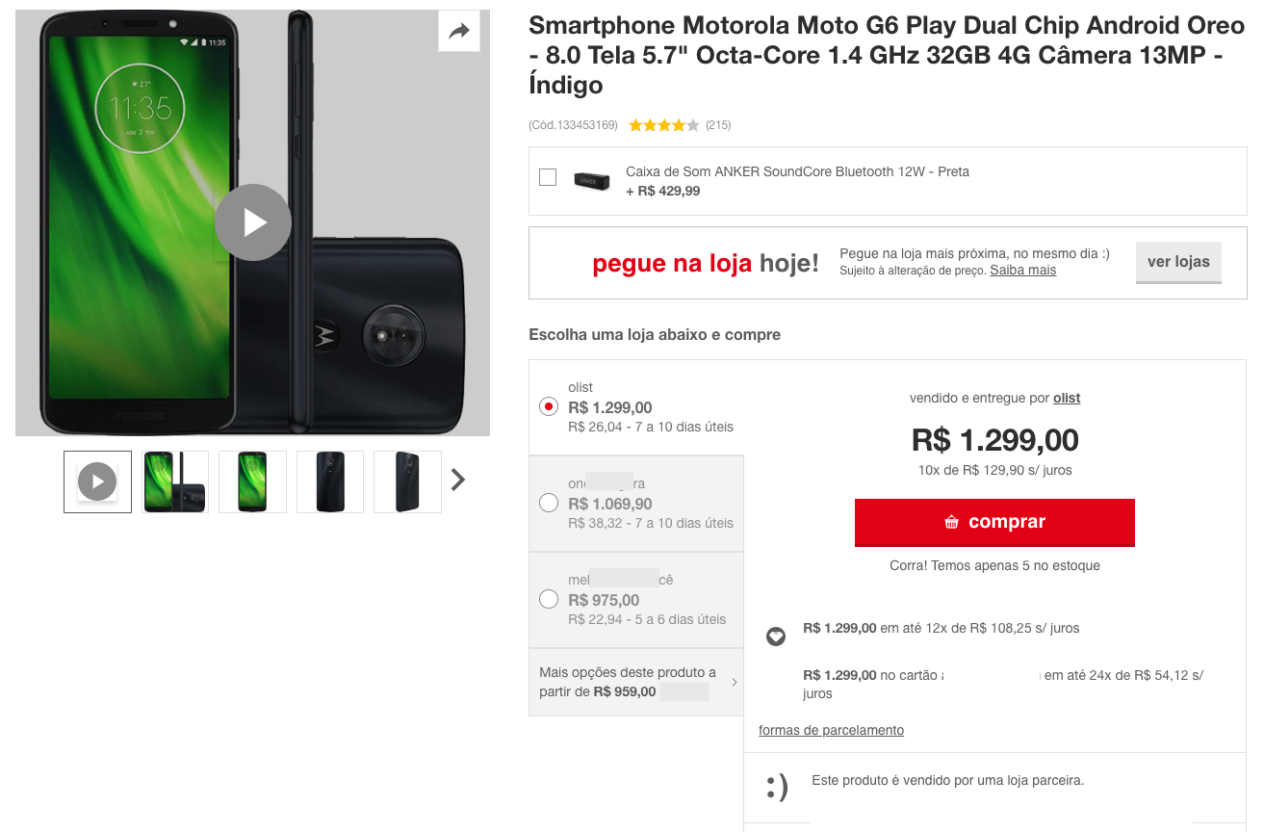

Example of a product listing on a marketplace
Data Schema
The data is divided in multiple datasets for better understanding and organization. Please refer to the following data schema when working with it:

Slide 6


Let’s get started by understanding some basic information about the data
Customers who ordered more than one time
Customers who ordered one time
Customer Table
3,345
4%
96,096
96%
Description of each column
column | entries | count distinct | most_freq | num freq | null values | dtype | mean | std | min | 25% | 50% | 75% | max
customer_id | 99441 | 99441 | unique | 1 | 0 | string | nan | nan | nan | nan | nan | nan | nan
customer_unique_id | 99441 | 96096 | 8d50f5eadf50201ccdcedfb9e2ac8455 | 17 | 0 | string | nan | nan | nan | nan | nan | nan | nan
customer_city | 99441 | 4119 | sao paulo | 15540 | 0 | string | nan | nan | nan | nan | nan | nan | nan
customer_state | 99441 | 27 | SP | 41746 | 0 | string | nan | nan | nan | nan | nan | nan | nan
customer_zip_code_prefix | 9944 | nan | nan | nan | 0 | int64 | 35137 | 29797 | 1003 | 11347 | 24416 | 58900 | 99990.
key to the orders dataset. Each order has a unique customer_id.
customer_id
The highest 10 cities that have customers who account for 35% of the total orders
customer_unique_id
unique identifier of a customer.
customer_city
customer city name
customer_state
customer state
first five digits of customer zip code
customer_zip_code_prefix

Slide 7
Seller Table
Description of each column
column | entries | count distinct | most_freq | num freq | null values | dtype | mean | std | min | 25% | 50% | 75% | max
seller_id | 3095 | 3095 | unique | 1 | 0 | object | nan | nan | nan | nan | nan | nan | nan
seller_city | 3095 | 611 | sao paulo | 694 | 0 | object | nan | nan | nan | nan | nan | nan | nan
seller_state | 3095 | 23 | SP | 1849 | 0 | object | nan | nan | nan | nan | nan | nan | nan
seller_zip_code_prefix | 3095 | nan | nan | nan | 0 | int64 | 32291 | 32713 | 1001 | 7094 | 14940 | 64552 | 99730
This dataset includes data about the sellers that fulfilled orders made at Olist. Use it to find the seller location and to identify which seller fulfilled each product.
seller_id
seller unique identifier
The highest 10 cities that have sellers
seller_city
seller city name
seller_state
seller state
Seller_zip_code_prefix
first 5 digits of seller zip code

Slide 8
Geolocation Table
Description of each column
column | entries | count distinct | most_freq | num freq | null values | dtype | mean | std | min | 25% | 50% | 75% | max
geolocation_city | 1000163 | 8011 | sao paulo | 135800 | 0 | string | nan | nan | nan | nan | nan | nan | nan
geolocation_state | 1000163 | 27 | SP | 404268 | 0 | string | nan | nan | nan | nan | nan | nan | nan
geolocation_zip_code_prefix | 1000163 | nan | nan | nan | 0 | Int64 | 36574 | 30549 | 1001 | 11075 | 26530 | 63504 | 99990
geolocation_lat | 1000163 | nan | nan | nan | 0 | Float64 | -21 | 6 | -37 | -24 | -23 | -20 | 45
geolocation_lng | 1000163 | nan | nan | nan | 0 | Float64 | -46 | 4 | -101 | -49 | -47 | -44 | 121
geolocation_city
first 5 digits of zip code
This dataset has information Brazilian zip codes and its lat/lng coordinates. Use it to plot maps and find distances between sellers and customers.
geolocation_lat
latitude
The top 10 most frequent cities
geolocation_lng
longitude
geolocation_zip_code_prefix
city name
geolocation_state
state

Slide 9


Order Items Table
Description of each column
column | entries | count distinct | most_freq | num freq | null values | dtype | mean | std | min | 25% | 50% | 75% | max
order_id | 112650 | 98666 | 8272b63d03f5f79c56e9e4120aec44ef | 21 | 0 | object | nan | nan | nan | nan | nan | nan | nan
product_id | 112650 | 32951 | aca2eb7d00ea1a7b8ebd4e68314663af | 527 | 0 | object | nan | nan | nan | nan | nan | nan | nan
seller_id | 112650 | 3095 | 6560211a19b47992c3666cc44a7e94c0 | 2033 | 0 | object | nan | nan | nan | nan | nan | nan | nan
shipping_limit_date | 112650 | 93318 | 2017-07-21 18:25:23 | 21 | 0 | object | nan | nan | nan | nan | nan | nan | nan
order_item_id | 112650 | nan | nan | nan | 0 | int64 | 1 | 1 | 1 | 1 | 1 | 1 | 21
price | 112650 | nan | nan | nan | 0 | float64 | 121 | 184 | 1 | 40 | 75 | 135 | 6735
freight_value | 112650 | nan | nan | nan | 0 | float64 | 20 | 16 | 0 | 13 | 16 | 21 | 410
order_id
order unique identifier
sequential number identifying number of items included in the same order
order_item_id
product_id
product unique identifier
seller_id
seller unique identifier
Shows the seller shipping limit date for handling the order over to the logistic partner
shipping_limit_date
This dataset includes data about the items purchased within each order.
Number of buys one item
Number of buys more than one item
price
item price
98,666
88%
13,984
12%
item freight value item (if an order has more than one item the freight value is splitted between items)
freight_value

Slide 10
Products Table
Description of each column
column | entries | count distinct | most_freq | num freq | null values | dtype | mean | std | min | 25% | 50% | 75% | max
product_id | 32951 | 32951 | unique | 1 | 0 | object | nan | nan | nan | nan | nan | nan | nan
product_category_name | 32341 | 73 | cama_mesa_banho | 3029 | 610 | object | nan | nan | nan | nan | nan | nan | nan
product_name_lenght | 32341 | nan | nan | nan | 610 | float64 | 48 | 10 | 5 | 42 | 51 | 57 | 76
product_description_lenght | 32341 | nan | nan | nan | 610 | float64 | 772 | 635 | 4 | 339 | 595 | 972 | 3992
product_photos_qty | 32341 | nan | nan | nan | 610 | float64 | 2 | 2 | 1 | 1 | 1 | 3 | 20
product_weight_g | 32949 | nan | nan | nan | 2 | float64 | 2276 | 4282 | 0 | 300 | 700 | 1900 | 40425
product_length_cm | 32949 | nan | nan | nan | 2 | float64 | 31 | 17 | 7 | 18 | 25 | 38 | 105
product_height_cm | 32949 | nan | nan | nan | 2 | float64 | 17 | 14 | 2 | 8 | 13 | 21 | 105
product_width_cm | 32949 | nan | nan | nan | 2 | float64 | 23 | 12 | 6 | 15 | 20 | 30 | 118
product_id
unique product identifier
text_format
product_
category_
name
root category of product, in Portuguese
product_
name_lengt
number of characters extracted from the product name
product_
description_
lenght
number of characters extracted from the product description
The highest 10 products have orders account for 61% of the total orders
product_
photos_qty
number of product published photos
product_
weight_g
product weight measured in grams
product_
length_cm
product length measured in centimeters
product_
height_cm
product height measured in centimeters
product_
width_cm
product width measured in centimeters

Slide 11
Orders Table
Description of each column
column | entries | count distinct | most_freq | num freq | first | last | null values | dtype
order_id | 99441 | 99441 | unique | 1 | NaT | NaT | 0 | object
customer_id | 99441 | 99441 | unique | 1 | NaT | NaT | 0 | object
order_status | 99441 | 8 | delivered | 96478 | NaT | NaT | 0 | object
order_purchase_timestamp | 99441 | 98875 | 2018-04-11 10:48:14 | 3 | 2016-09-04 21:15:19 | 2018-10-17 17:30:18 | 0 | datetime64[ns]
order_approved_at | 99281 | 90733 | 2018-02-27 04:31:10 | 9 | 2016-09-15 12:16:38 | 2018-09-03 17:40:06 | 160 | datetime64[ns]
order_delivered_carrier_date | 97658 | 81018 | 2018-05-09 15:48:00 | 47 | 2016-10-08 10:34:01 | 2018-09-11 19:48:28 | 1783 | datetime64[ns]
order_delivered_customer_date | 96476 | 95664 | 2018-05-08 23:38:46 | 3 | 2016-10-11 13:46:32 | 2018-10-17 13:22:46 | 2965 | datetime64[ns]
order_estimated_delivery_date | 99441 | 459 | 2017-12-20 00:00:00 | 522 | 2016-09-30 00:00:00 | 2018-11-12 00:00:00 | 0 | datetime64[ns]
unique identifier of the order
order_id
customer_id
key to the customer dataset. Each order has a unique customer_id
order_status
Reference to the order status (delivered, shipped, etc)
order_purchase_
timestamp
Shows the purchase timestamp
order_approved_at
Shows the payment approval timestamp
This is the core dataset. From each order you might find all other information
order_status | most freq
delivered | 96478
shipped | 1107
canceled | 625
unavailable | 609
invoiced | 314
processing | 301
created | 5
approved | 2
Shows the order posting timestamp. When it was handled to the logistic partner
order_delivered_
carrier_date
order_delivered_
customer_date
Shows the actual order delivery date to the customer.
Shows the estimated delivery date that was informed to customer at the purchase moment
order_estimated_delivery_date

Slide 12
Payments Table
Description of each column
column | entries | count distinct | most_freq | num freq | null values | dtype | mean | std | min | 25% | 50% | 75% | max
order_id | 103886 | 99440 | fa65dad1b0e818e3ccc5cb0e39231352 | 29 | 0 | object | nan | nan | nan | nan | nan | nan | nan
payment_type | 103886 | 5 | credit_card | 76795 | 0 | object | nan | nan | nan | nan | nan | nan | nan
payment_sequential | 103886 | nan | nan | nan | 0 | int64 | 1 | 1 | 1 | 1 | 1 | 1 | 29
payment_ installments | 103886 | nan | nan | nan | 0 | int64 | 3 | 3 | 0 | 1 | 1 | 4 | 24
payment_value | 103886 | nan | nan | nan | 0 | float64 | 154 | 217 | 0 | 57 | 100 | 172 | 13664
order_id
unique identifier
of an order
payment_
sequential
a customer may pay an order with more than one payment method. If he does so, a sequence will be created to
Payment
_type
method of payment chosen by the customer
Total transaction by payment type
payment_
installments
number of installments chosen by the customer
payment_
value
transaction value
This dataset includes data about the orders payment options

Slide 13
Description of each column
Reviews Table
column | entries | count distinct | most_freq | num freq | first | last | null values | dtype | mean | std | min | 25% | 50% | 75% | max
review_id | 99224 | 98410 | 7b606b0d57b078384f0b58eac1d41d78 | 3 | NaT | NaT | 0 | object | nan | nan | nan | nan | nan | nan | nan
order_id | 99224 | 98673 | c88b1d1b157a9999ce368f218a407141 | 3 | NaT | NaT | 0 | object | nan | nan | nan | nan | nan | nan | nan
review_comment_title | 11568 | 4527 | Recomendo | 423 | NaT | NaT | 87656 | object | nan | nan | nan | nan | nan | nan | nan
review_comment_message | 40977 | 36159 | Muito bom | 230 | NaT | NaT | 58247 | object | nan | nan | nan | nan | nan | nan | nan
review_creation_date | 99224 | 636 | 2017-12-19 00:00:00 | 463 | 2016-10-02 00:00:00 | 2018-08-31 00:00:00 | 0 | datetime64[ns] | nan | nan | nan | nan | nan | nan | nan
review_answer_timestamp | 99224 | 98248 | 2017-06-15 23:21:05 | 4 | 2016-10-07 18:32:28 | 2018-10-29 12:27:35 | 0 | datetime64[ns] | nan | nan | nan | nan | nan | nan | nan
review_score | 99224 | nan | nan | nan | NaT | NaT | 0 | int64 | 4 | 1 | 1 | 4 | 5 | 5 | 5
review_id
unique review
identifier
order_id
unique order
identifier
review_
Comment
_title
Comment title from the review left by the customer, in Portuguese
review_
comment_
message
Comment message from the review left by the customer, in Portuguese
review_
Creation
_date
Shows the date in which the satisfaction survey was sent to the customer
review_
answer_
timestamp
Shows satisfaction survey answer timestamp
After a customer purchases the product from Olist Store a seller gets notified to fulfill that order. Once the customer receives the product, or the estimated delivery date is due, the customer gets a satisfaction survey by email where he can give a note for the purchase experience and write down some comments
review_
score
Note ranging from 1 to 5 given by the customer on a satisfaction survey

Slide 14

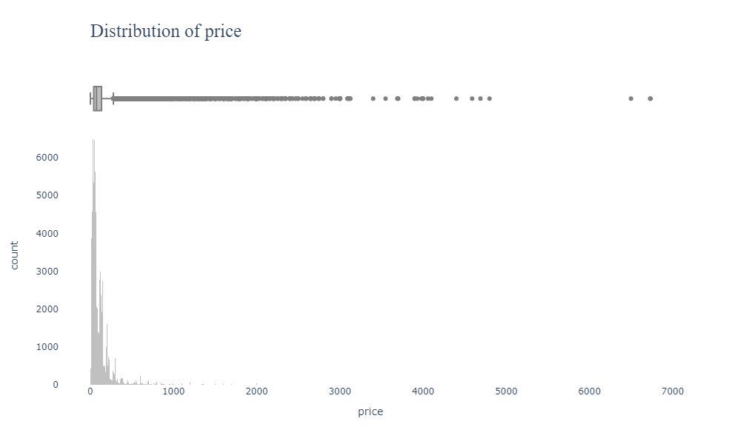

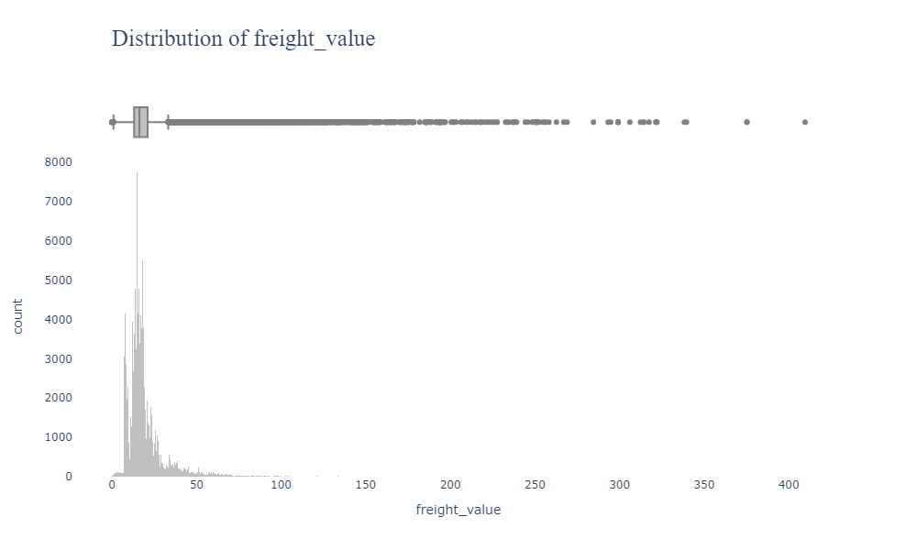
Exploratory Data Analysis (EDA)
Average Price 120
Standard Deviation 184
Variance 33,896
Minimum Price 0.85
Maximum Price 6,735
25% of the Price Under 39
50% of the Price Under 74
75% of the Price Under 134
75% to 100% of the price between 134 to 6,735
Average Freight Value 20
Standard Deviation 15
Variance 250
Minimum Freight Value 0
Maximum Freight Value 409
25% of the Freight Value Under 13
50% of the Freight Value Under 16
75% of the Freight Value Under 21
75% to 100% of the Freight Value between 21 to 409

Slide 15
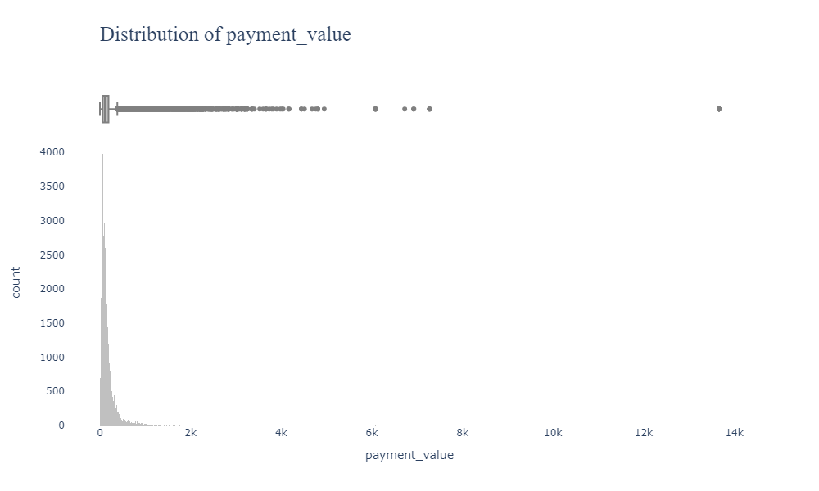
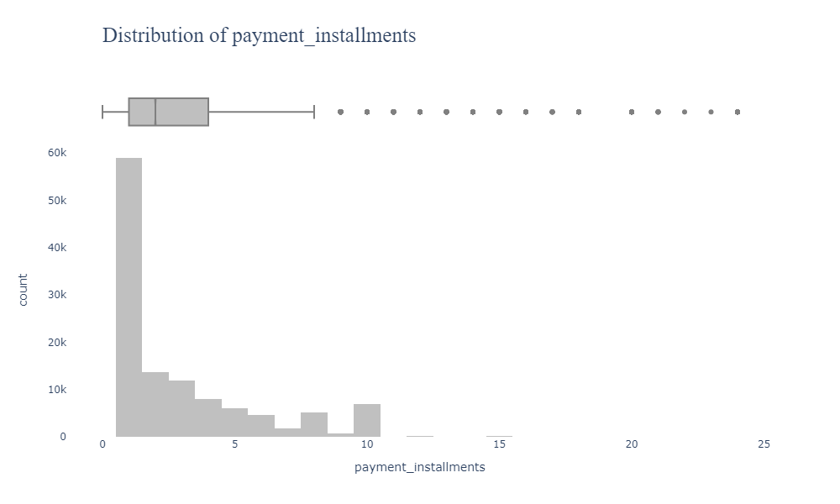
Exploratory Data Analysis (EDA)
Average Payment Value 127
Standard Deviation 267
Variance 71,348
Minimum Payment Value 0
Maximum Payment Value 13,664
25% of the Payment Value Under 60
50% of the Payment Value Under 108
75% of the Payment Value Under 189
75% to 100% of the Payment Value between 189 to 13,664
Average Payment Installments 3
Standard Deviation 2.7
Variance 7.7
Minimum Payment Installments 1
Maximum Review Score 24
25% of the Payment Installments Under 1
50% of the Payment Installments Under 2
75% of the Payment Installments Under 4
75% to 100% of the Payment Installments between
4 to 24

Slide 16
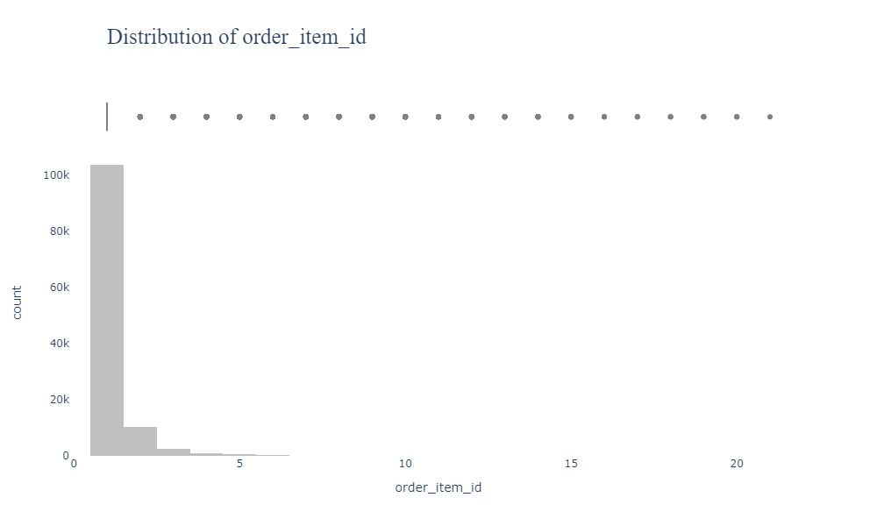
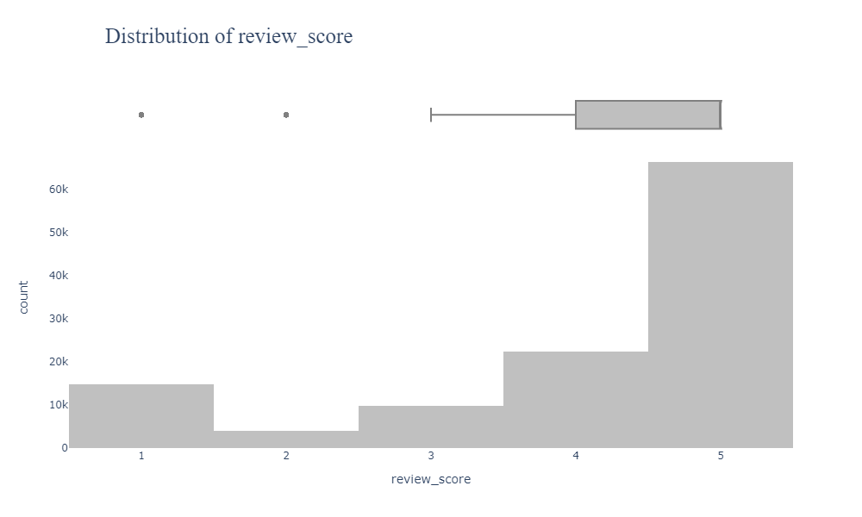
Exploratory Data Analysis (EDA)
Average Order Item Id 1.1
Standard Deviation 0.69
Variance 0.48
Minimum Order Item Id 1
Maximum Order Item Id 21
25% of the Order Item Id Under 1
50% of the Order Item Id Under 1
75% of the Order Item Id Under 1
75% to 100% of the Order Item Id between 1 to 21
Average Review Score 4
Standard Deviation 1.3
Variance 2
Minimum Review Score 1
Maximum Review Score 5
25% of the Review Score Under 4
50% of the Review Score Under 5
75% of the Review Score Under 5
75% to 100% of the Review Score between 5 to 5

Slide 17

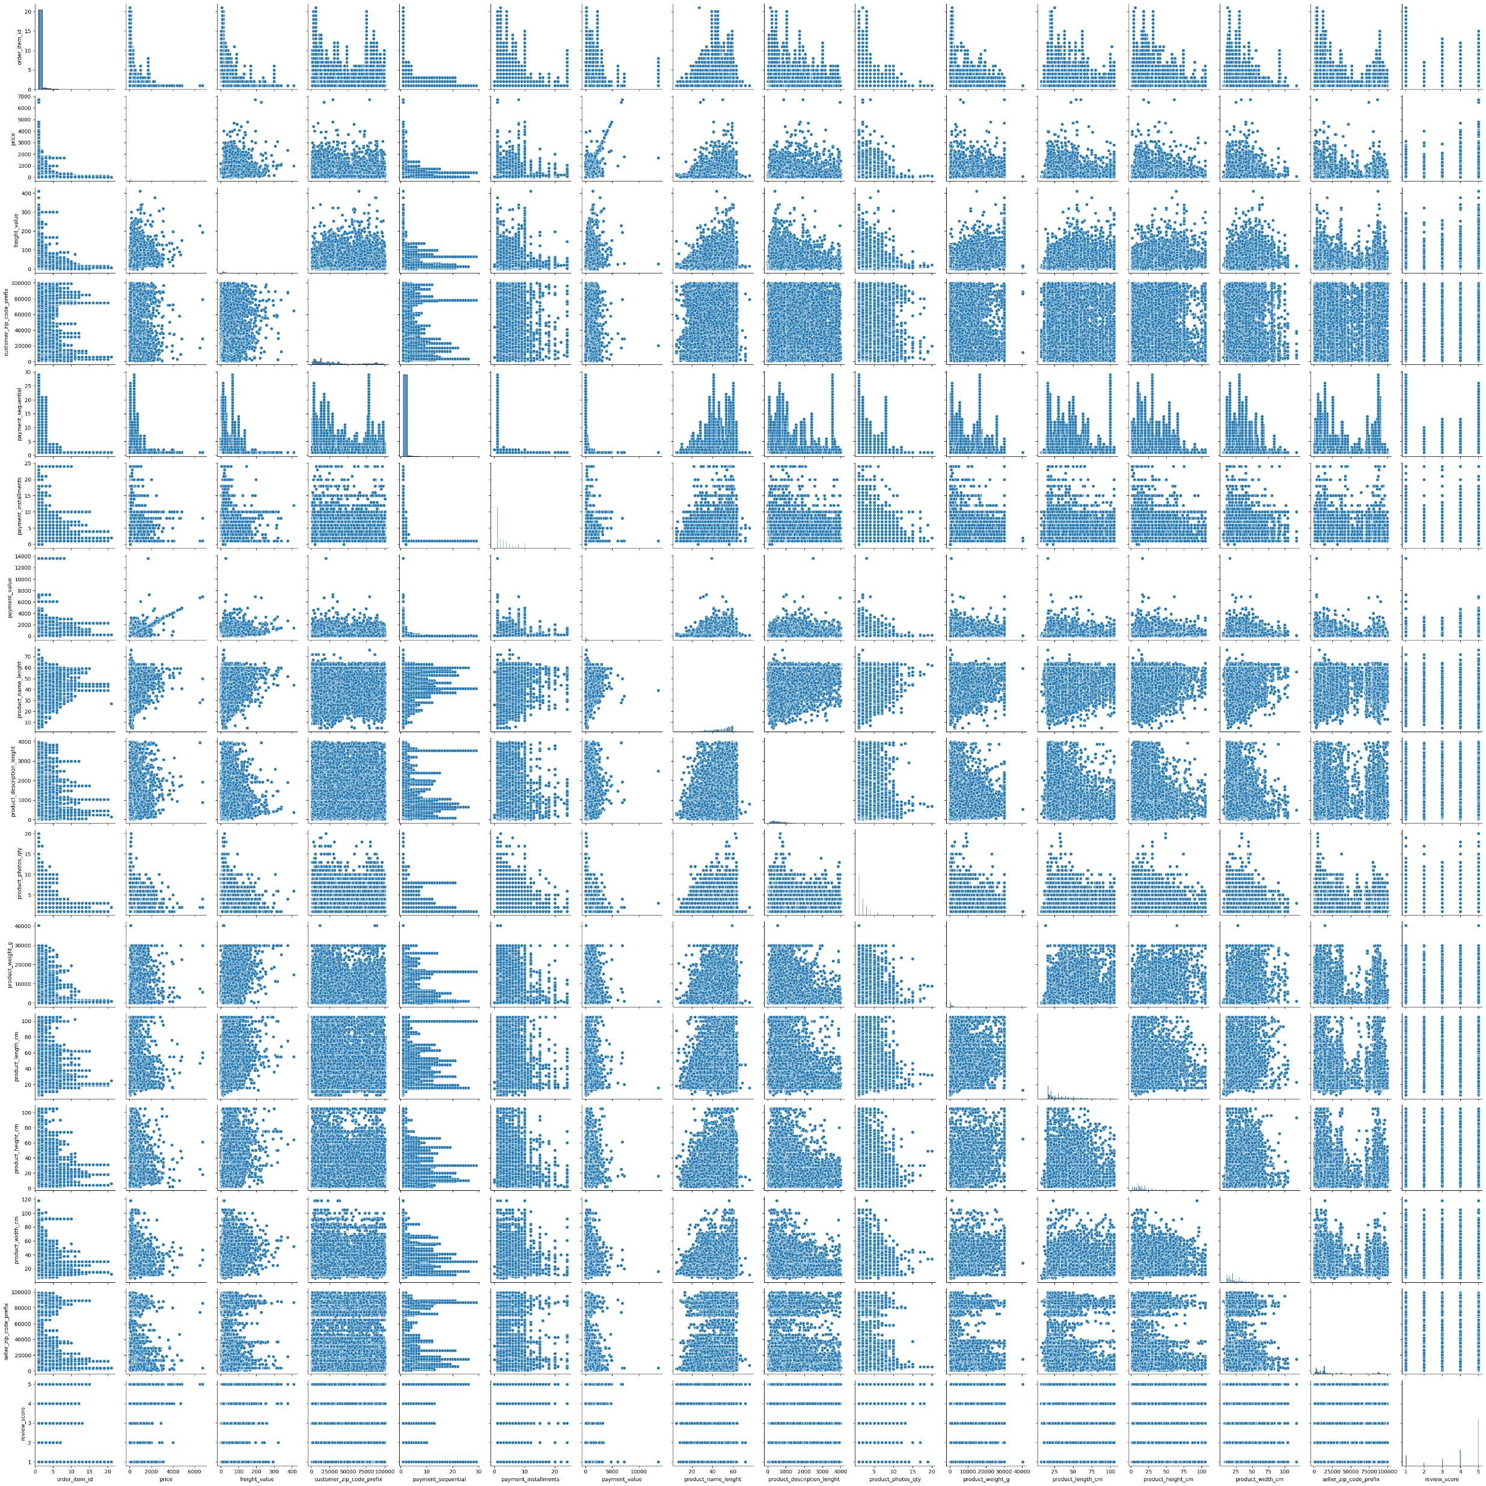
Relationship of each column with each other

Slide 18


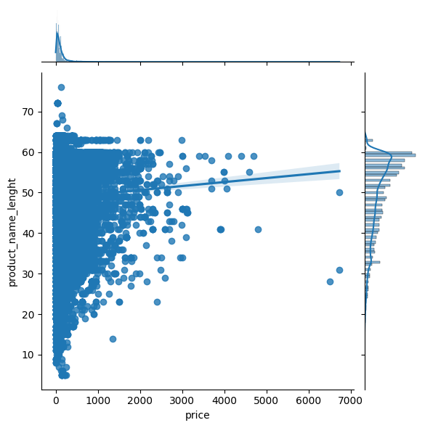
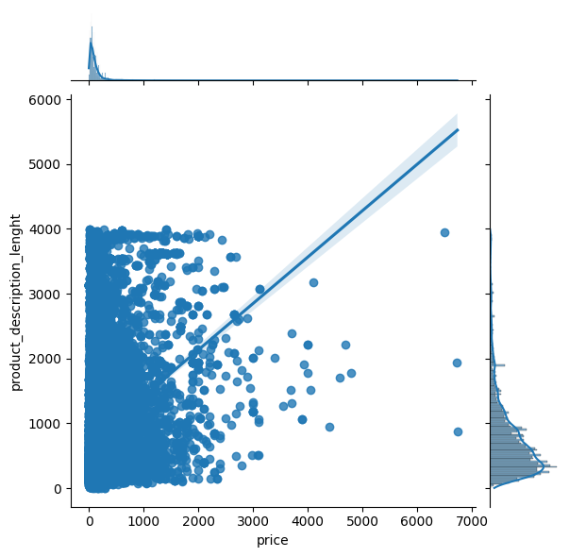
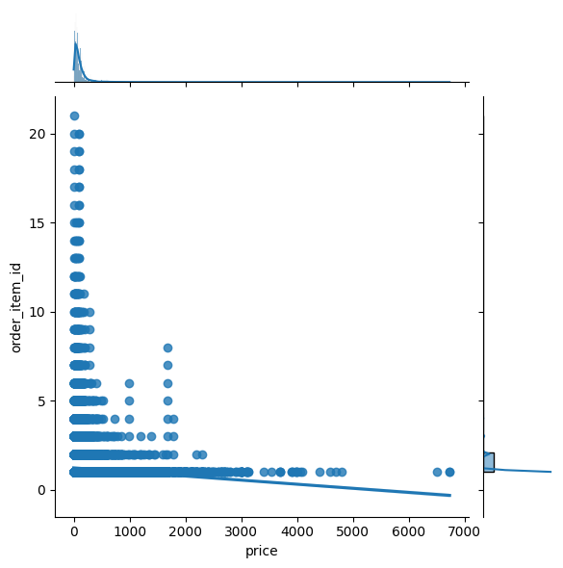
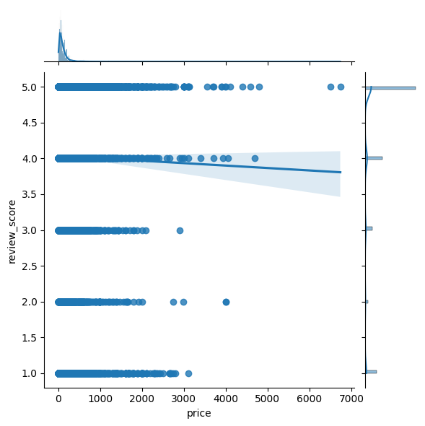
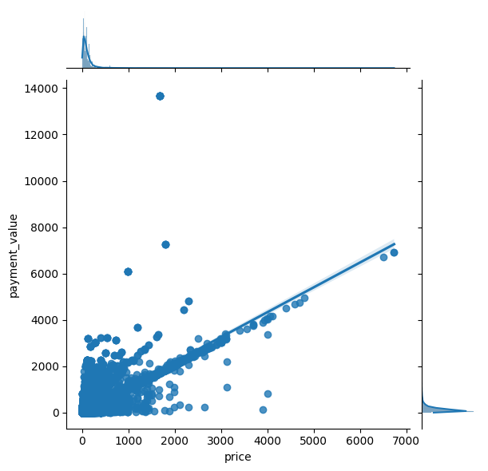
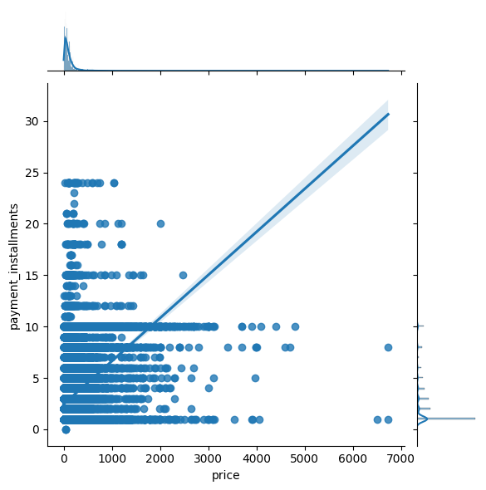
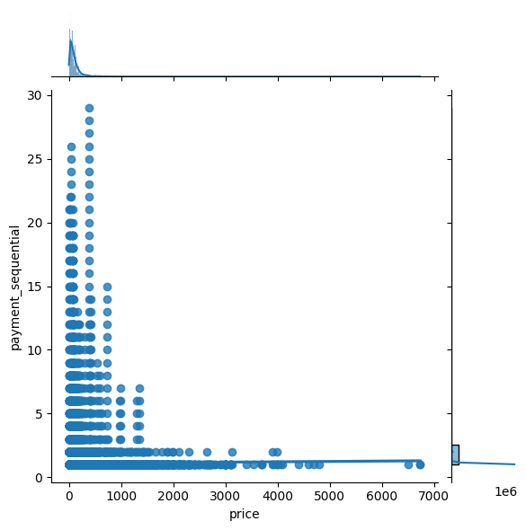
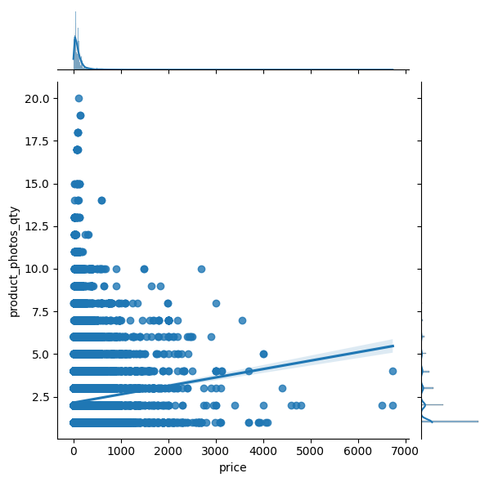
Best effective features on the price
Apparent from 40 to 60 product name characters are the best option to buy the product
Apparent from 1 to 2000 product description characters are the best option to buy the product
Determines that customers purchase from 1 to 5 items most time and most profitable as well
Most people are leaving reviews between 4 to 5
It seems there is a relationship between price and payment value,
increase price increase payment value
Obvious that most payment installments are between 1 to 10 and most booming to the price
Obvious here that most people use one payment type sequentially and don't change it a lot and most profitable
It seems that 1 to 10 photos are enough to buy the product

Slide 19

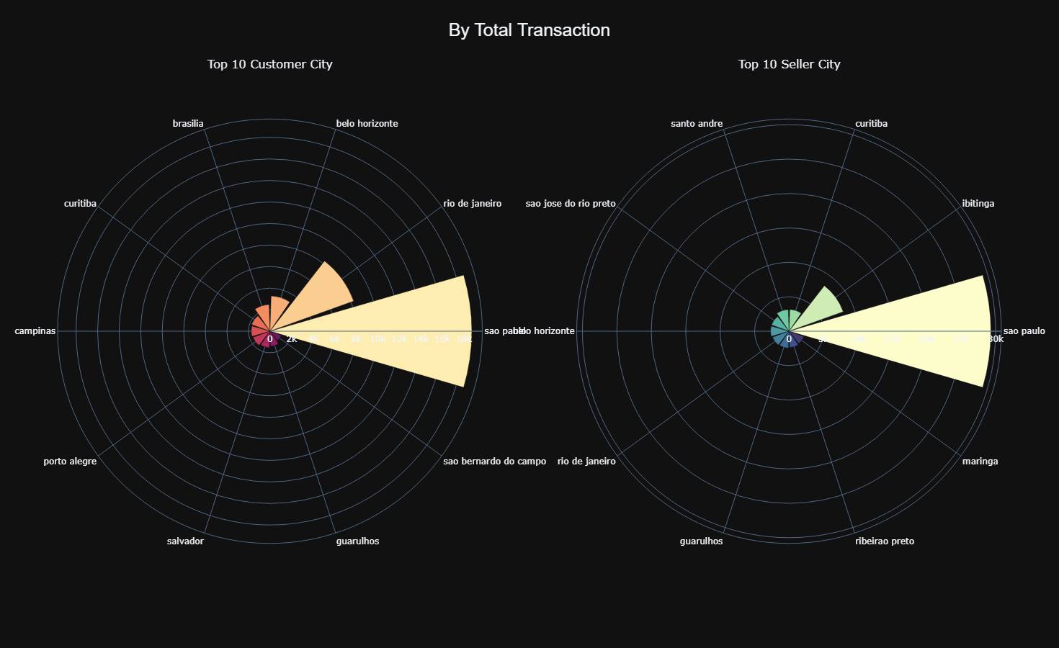
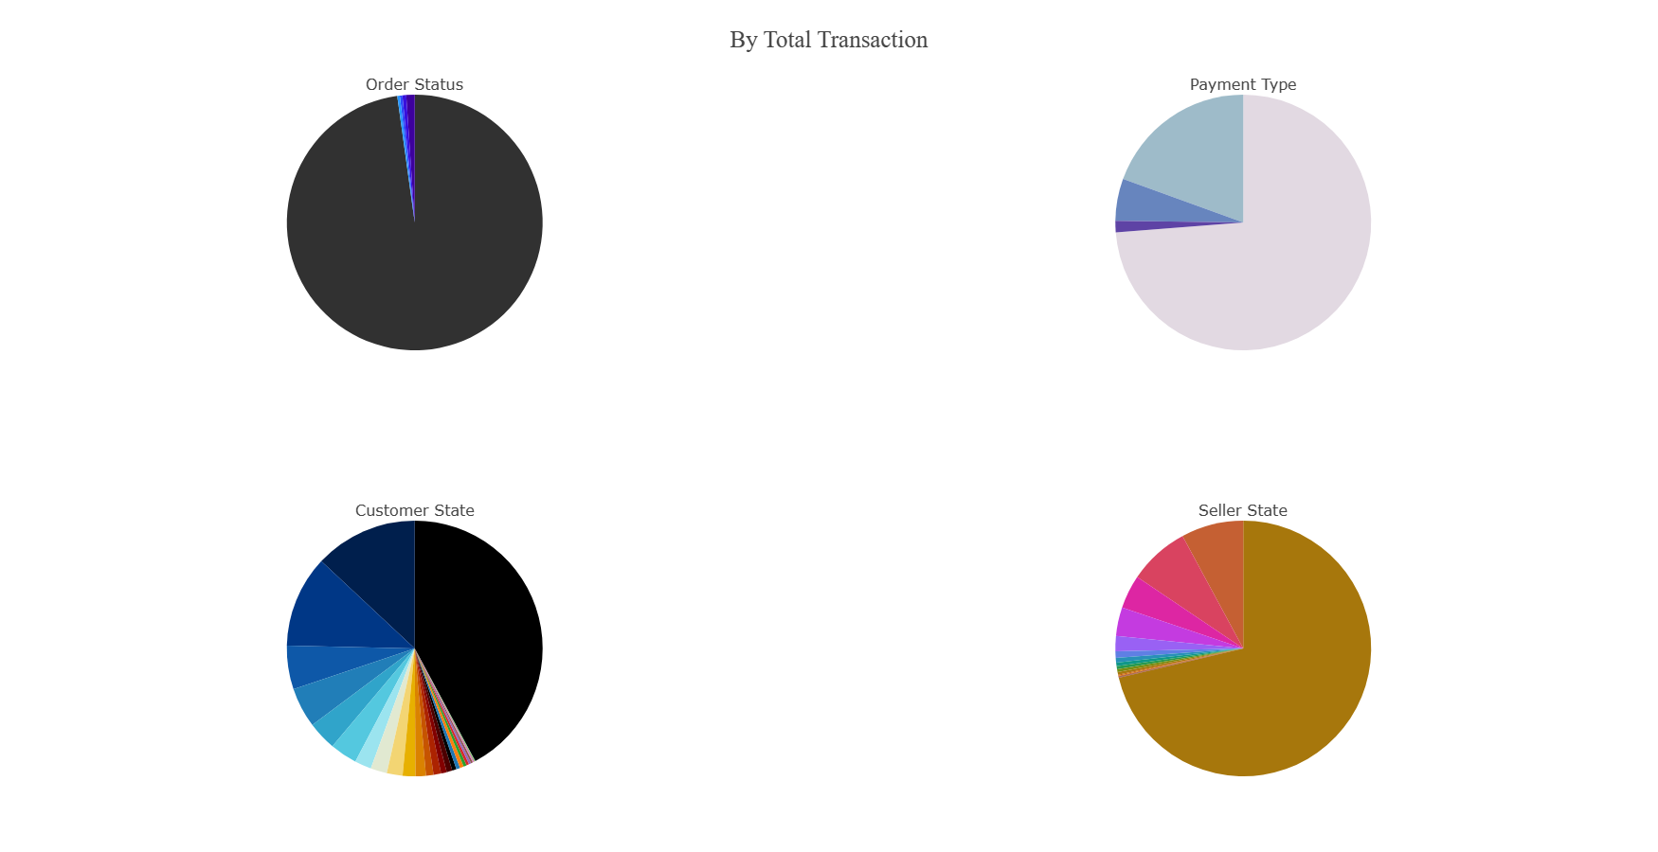
Explore Categorical Univariate Data
To see interactivity plotly2.html
To see interactivity plotly1.html

Slide 20
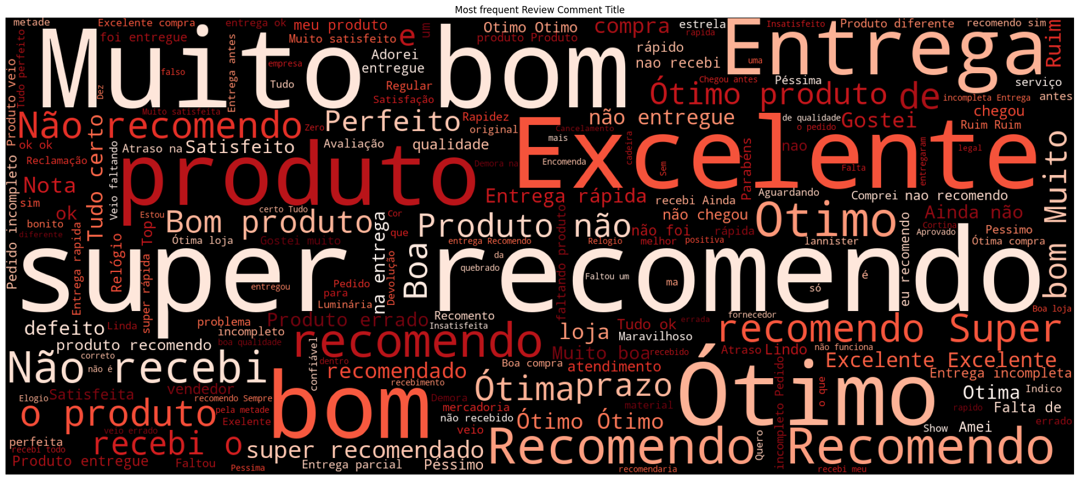
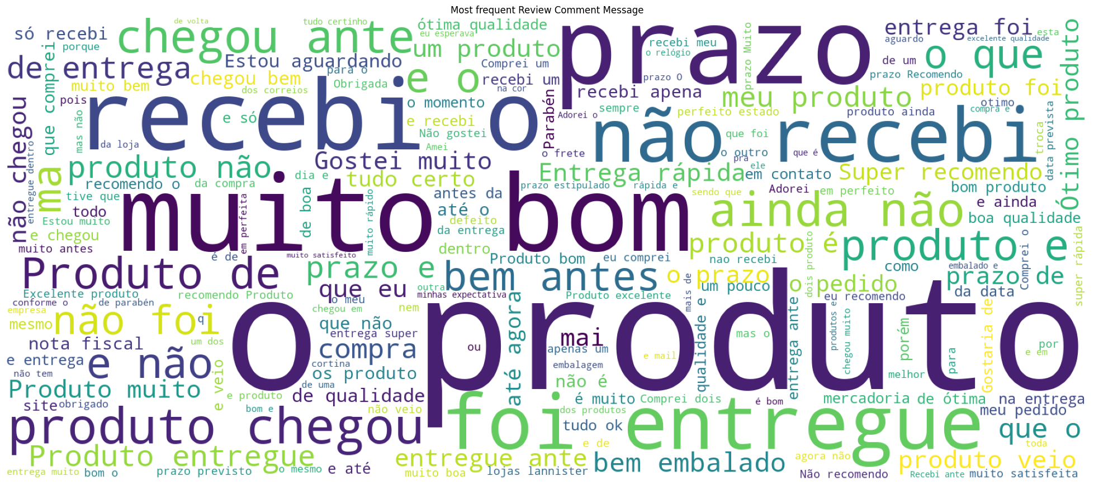
Explore Categorical Univariate Data

Slide 21
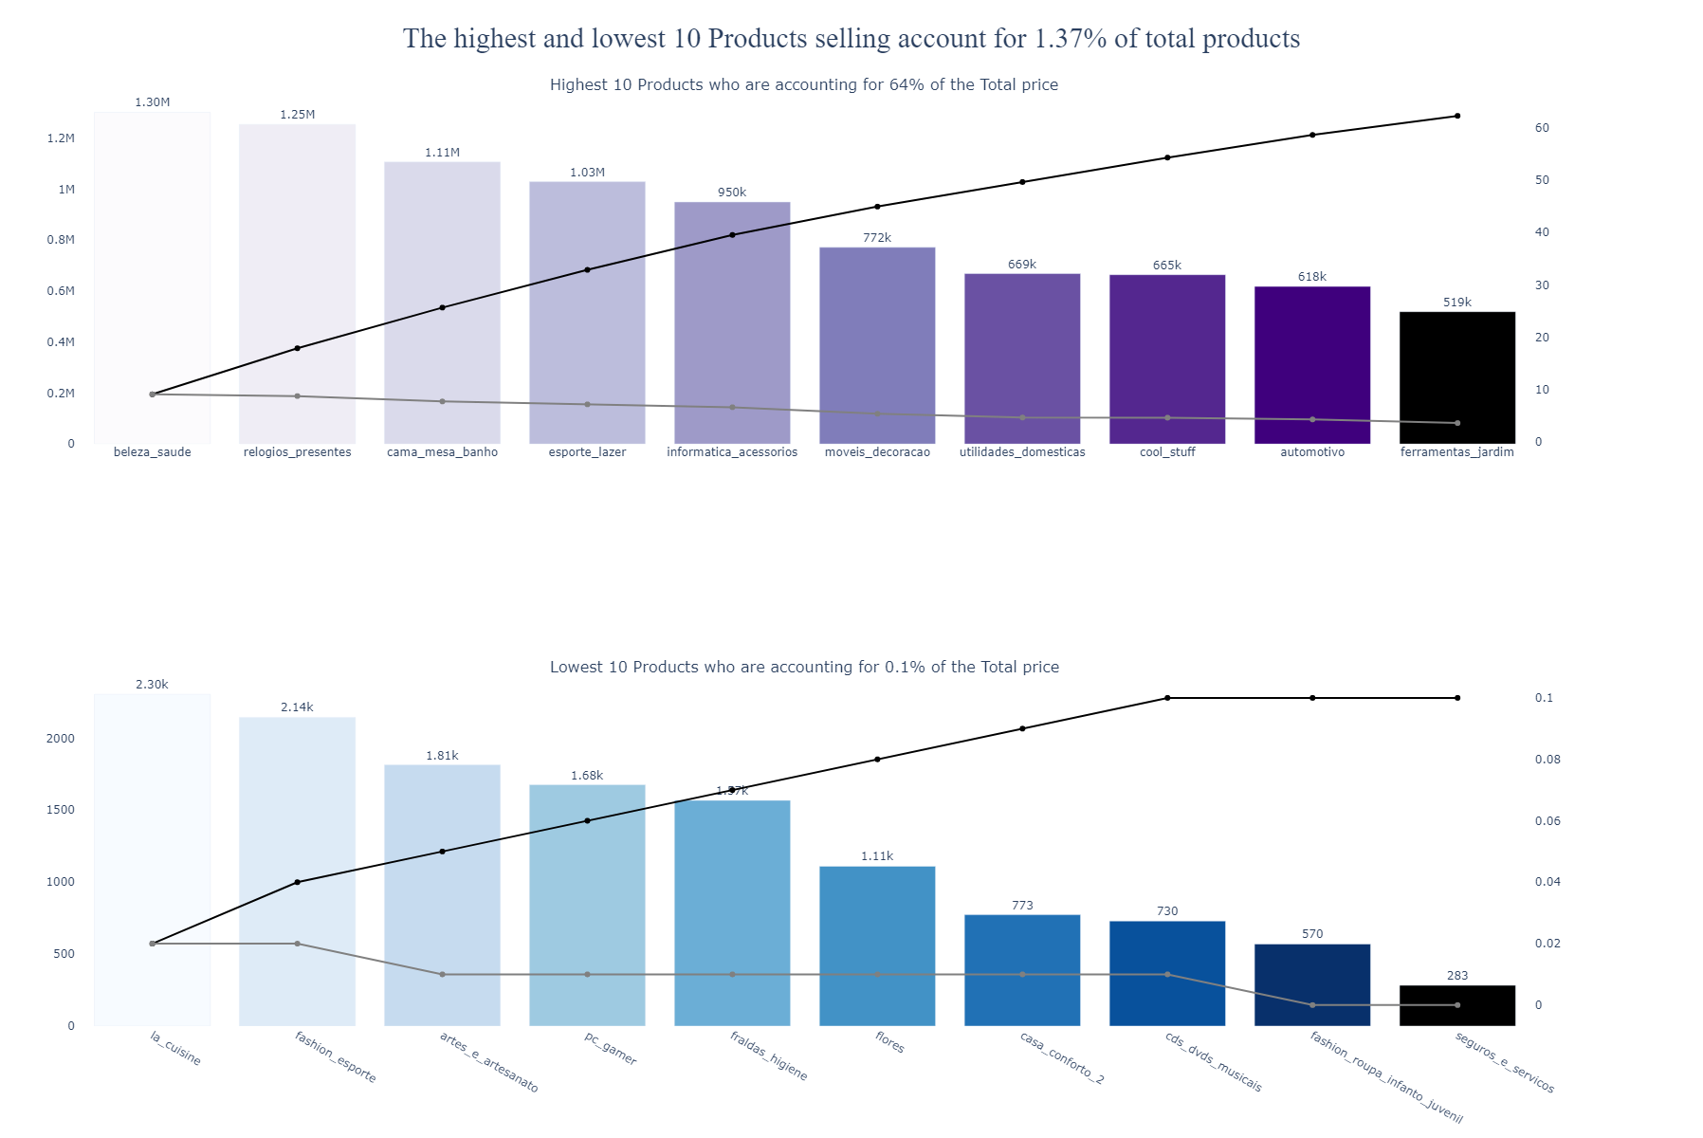
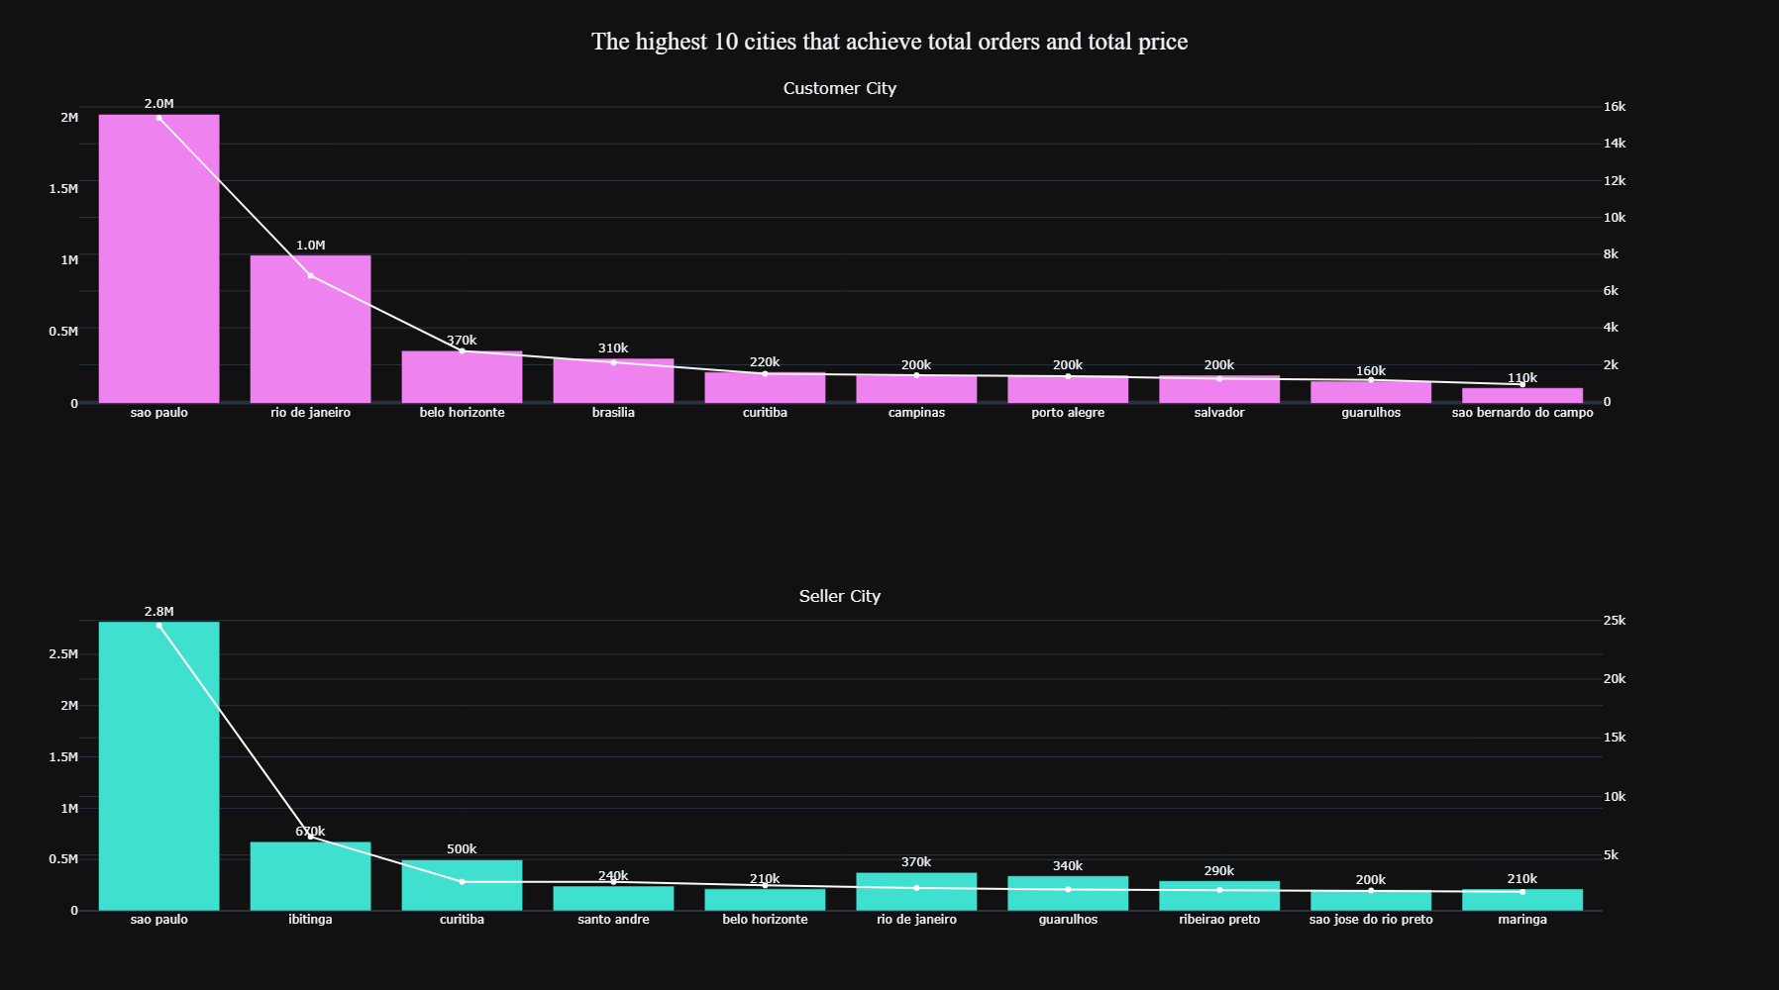
Explore Categorical bivariate Data
To see interactivity plotly4.html
To see interactivity plotly3.html

Slide 22

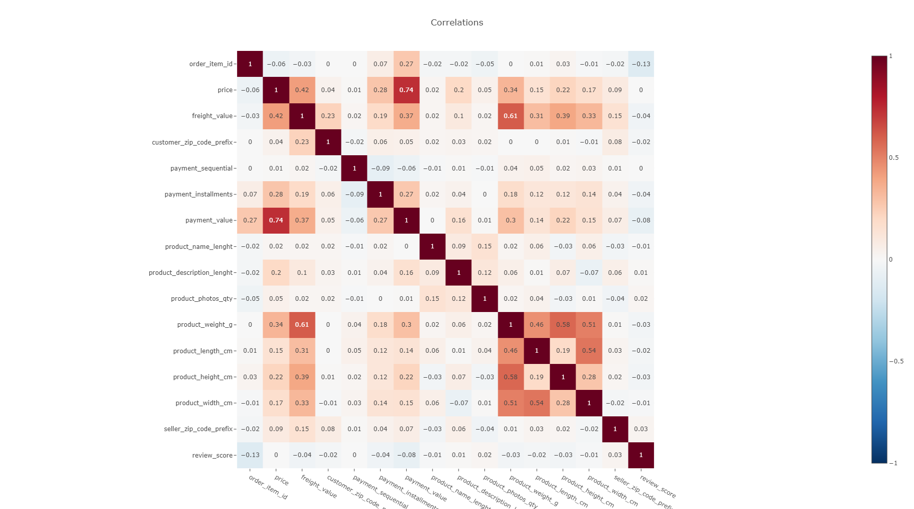
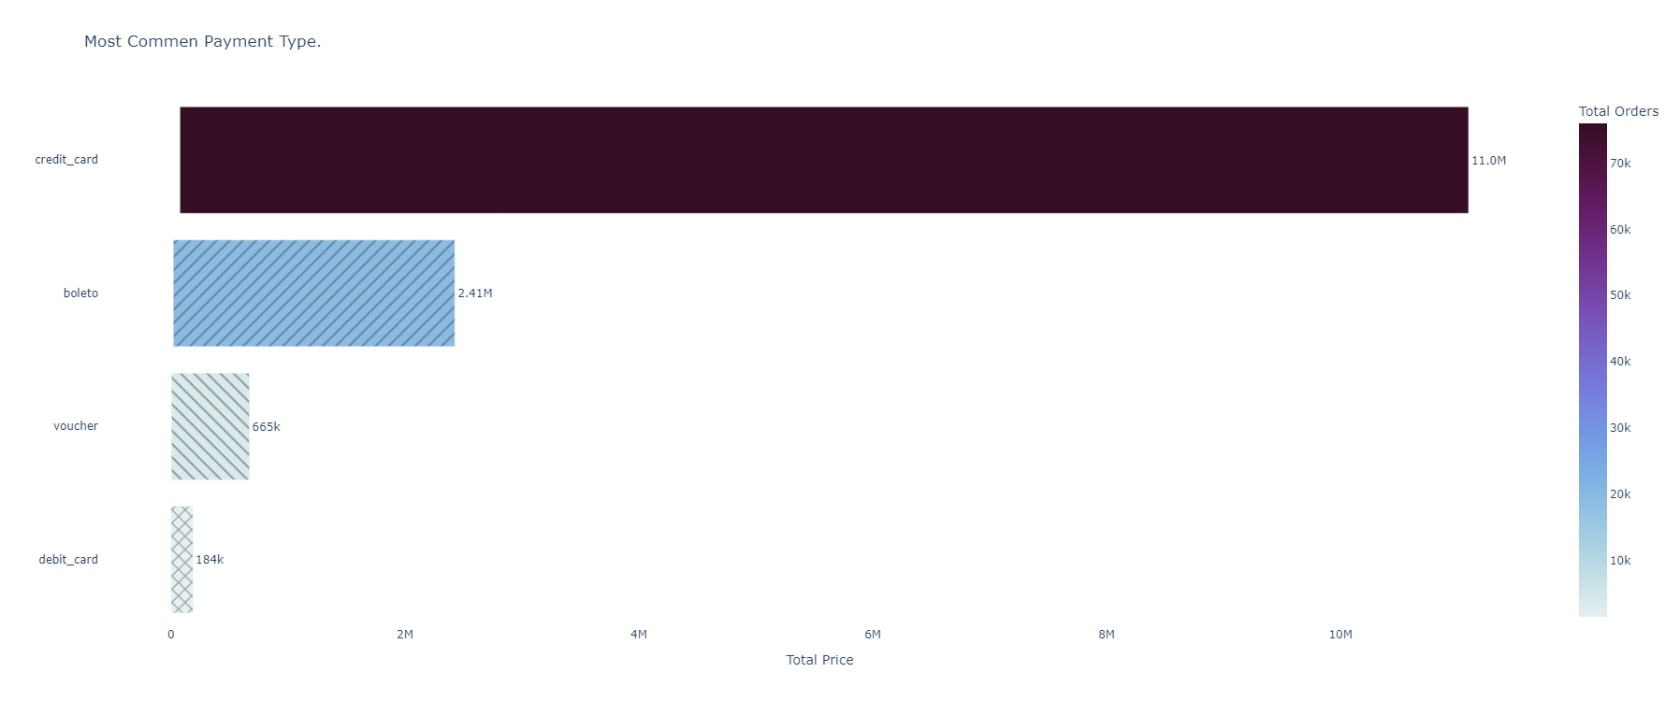
The heat map shows the correlation between each column
To see interactivity plotly5.html

Slide 23

Let's dive into the analysis and answer business questions

Slide 24

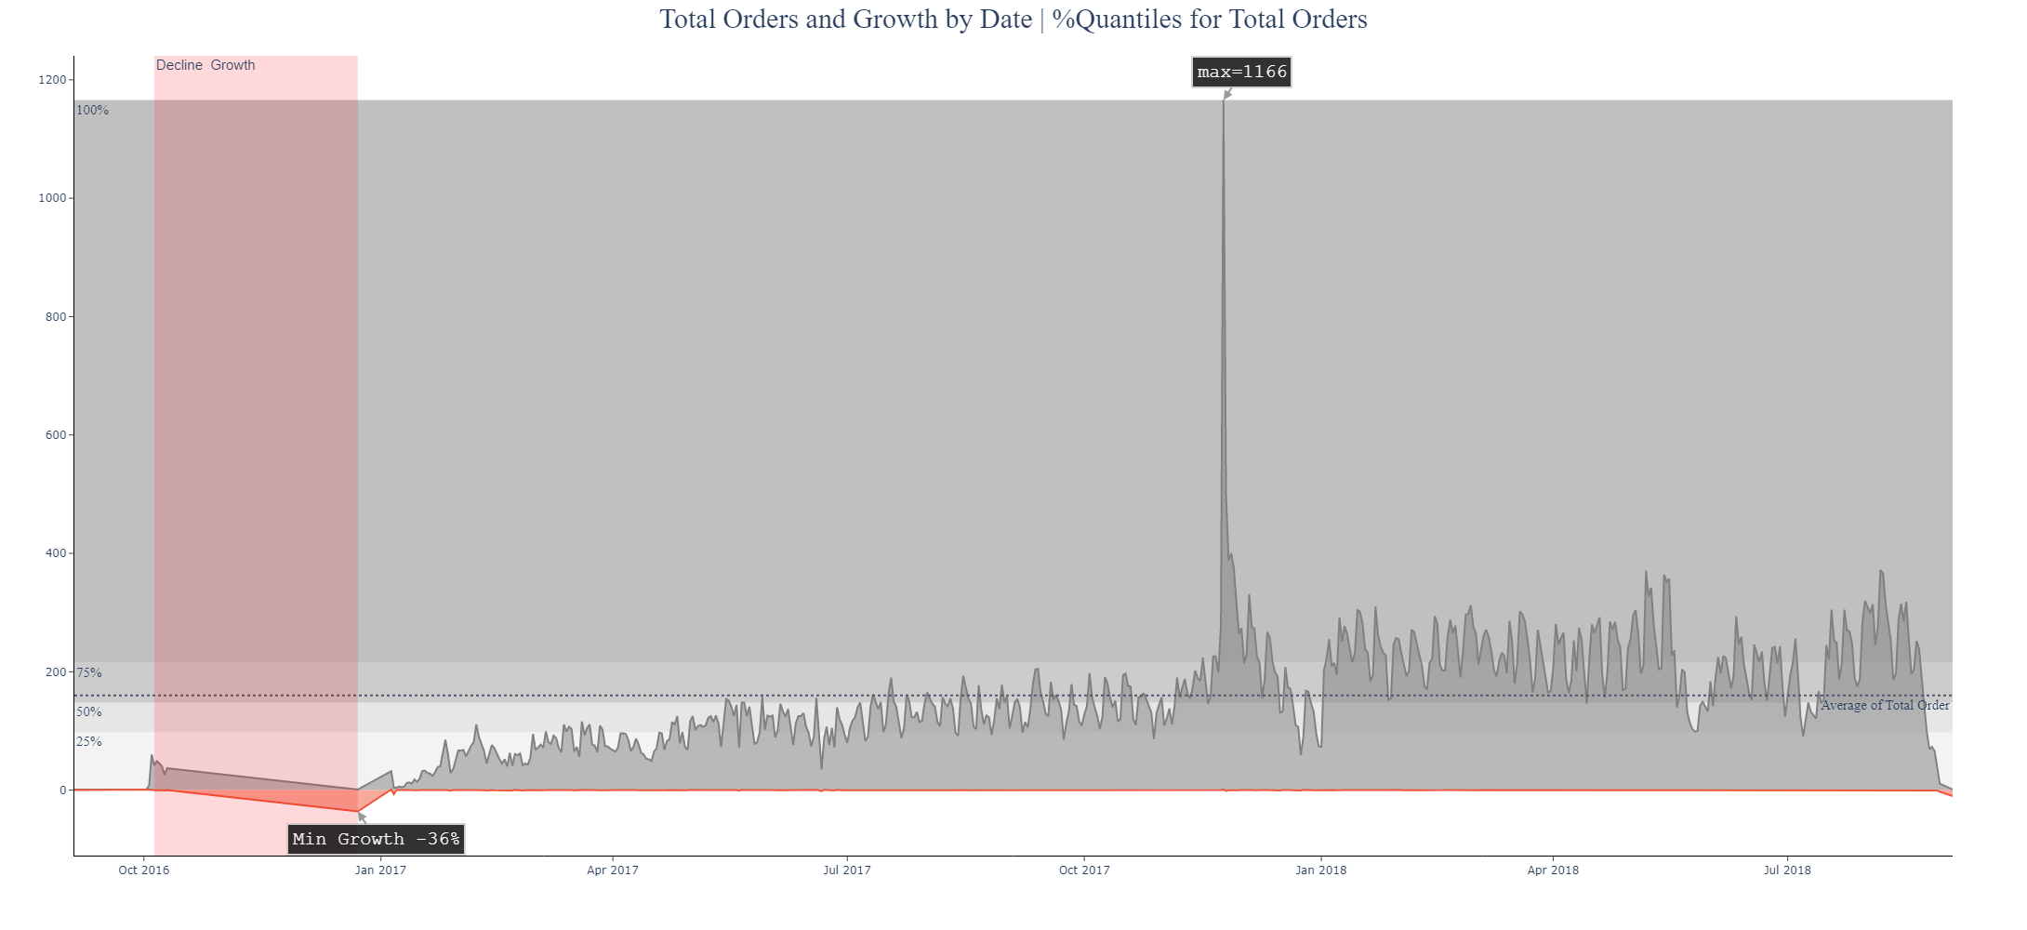
Insights
How many orders for each date and what is the growth of it?
To see interactivity Q1.html
Decline Growth between '5 Oct 2016' to '23 Dec 2016’
In the range of 0 to 98 orders, 25% of customers take orders
50% of customers take orders under 148
Under 215 orders are taken by 50% of customer
Half to 100% of customers place orders between 215 and 1166
From '2017 Nov 11' to '2017 Dec 1' is when the peak occurred
In the period from '2016 Sep 5' to '2017 Jul 17’, all orders were below the total average
In the period from '2018 Jan 5' to '2018 May 20', all orders exceeded the total average

Slide 25
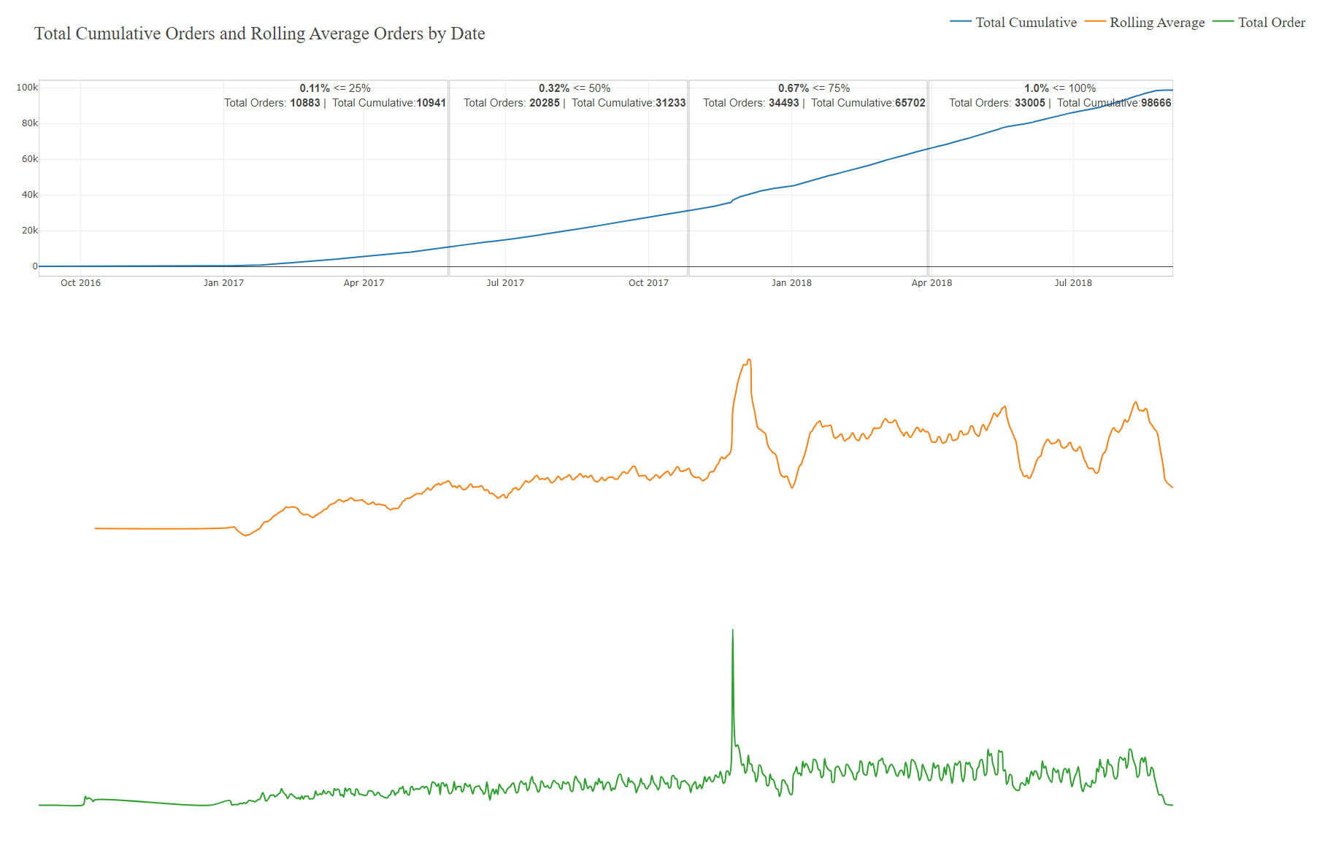
Insights
What is the total cumulative of orders and rolling average of orders?
To see interactivity Q2.html
The period before '2018 Mar 30' accounted for 67% of total orders
In the period from '2016 Sep 1' to '2017 May 25' total orders of 10,883k and total cumulative orders of 10,941 and 0.11% of Total cumulative orders accounting for 25% of total cumulative orders
In the period from '2017 Oct 26' to '2017 May 25' total orders of 20,285k and total cumulative orders of 31,233 and 0.32% of Total cumulative orders accounting for 50% of total cumulative orders
In the period from '2017 May 25' to '2018 Mar 30' total orders of 34,493k and total cumulative orders of 65,702 and 0.67% of Total cumulative orders accounting for 75% of total cumulative orders
In the period from '2018 Mar 30' to '2018 Sep 3' total orders of 33,005k and total cumulative orders of 98,666 and 1.0% of Total cumulative orders accounting for 100% of total cumulative orders

Slide 26
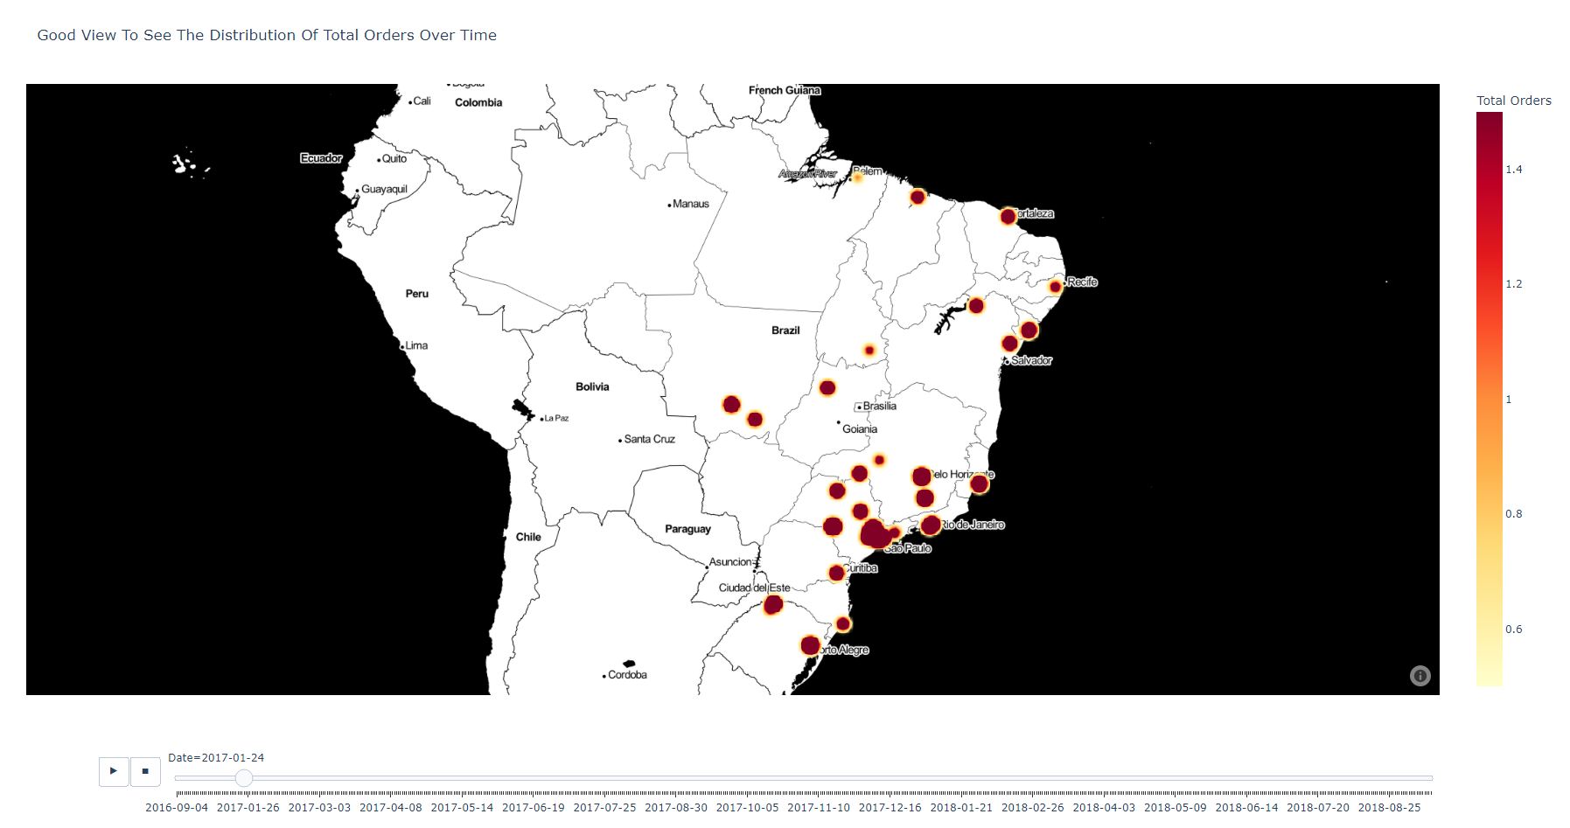
What is the distribution of total orders over time?
To see interactivity Q3.html

Slide 27
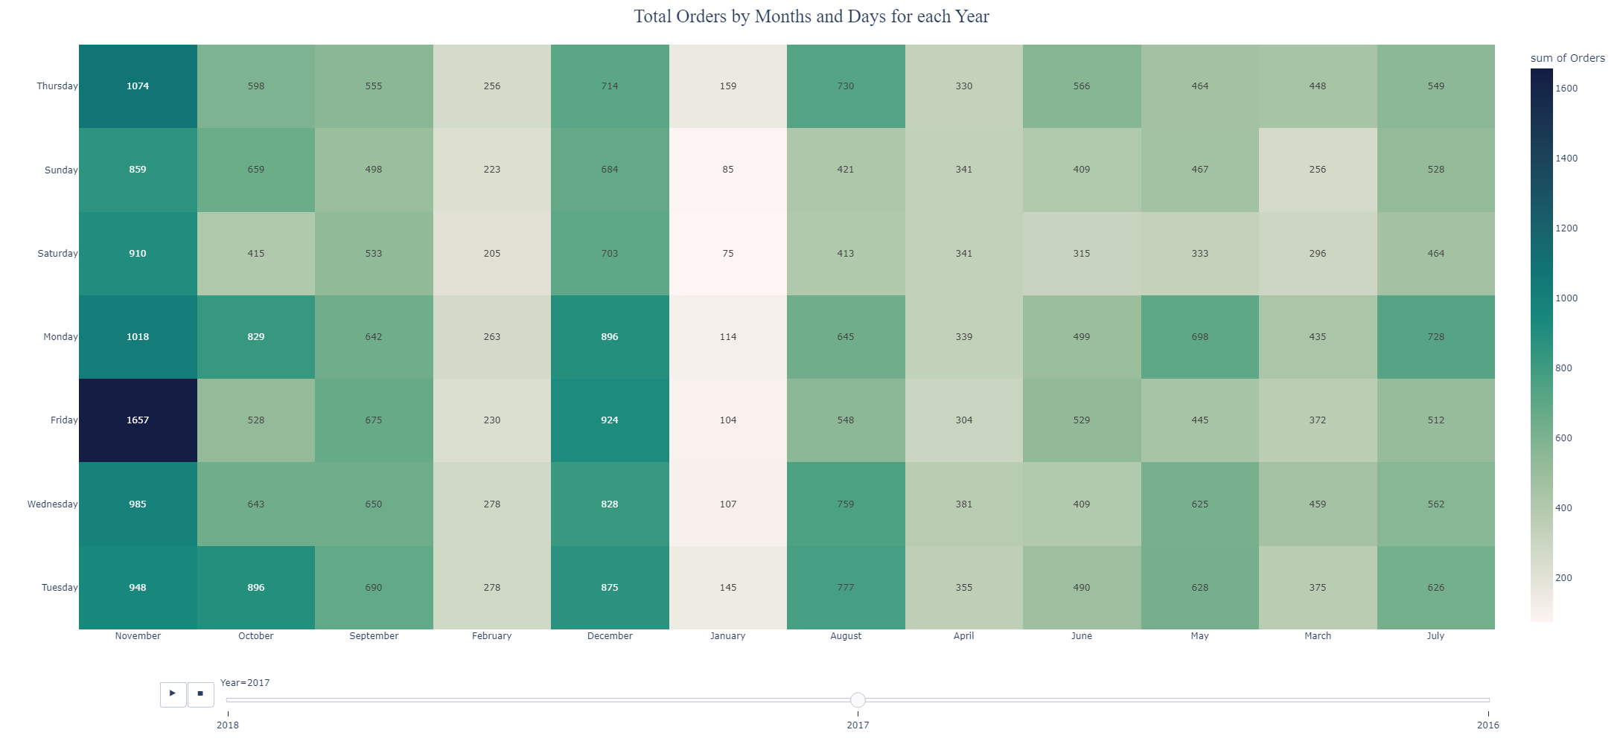

What are the most day and months that have total orders?
To see interactivity Q4.html
Insights
September, December 2016, and September 2018 are the lowest months that have orders in it
The greatest number of orders was on Friday, Nov 2017
The greatest number of orders was in 2018 but in September purchased only one order
2018 ['January', 'March', 'April', 'May', 'February', 'August', 'July', 'June'] accounting for 54% of all total orders

Slide 28

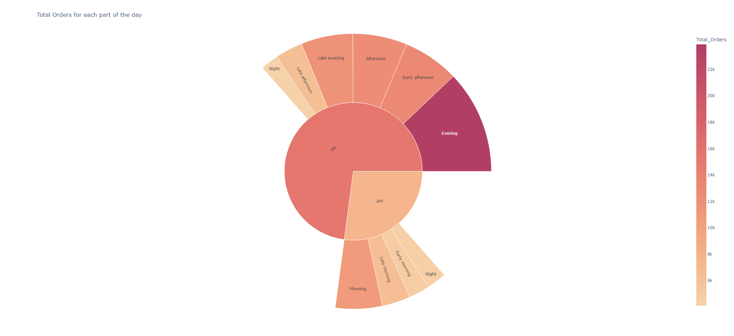
Which part of the day has the highest number of total orders?
Total Orders for each part of the day
Insights
50% of total orders are made in the Evening, Early afternoon, and Afternoon
The highest number of total orders is in the Evening 23,909k
Customers are mostly purchasing at night than morning
The lowest number of total orders in Early morning, Night (9pm to 12 midnight), Night (12 midnight to 4am) accounting for 14% all total Orders
To see interactivity Q5.html

Slide 29
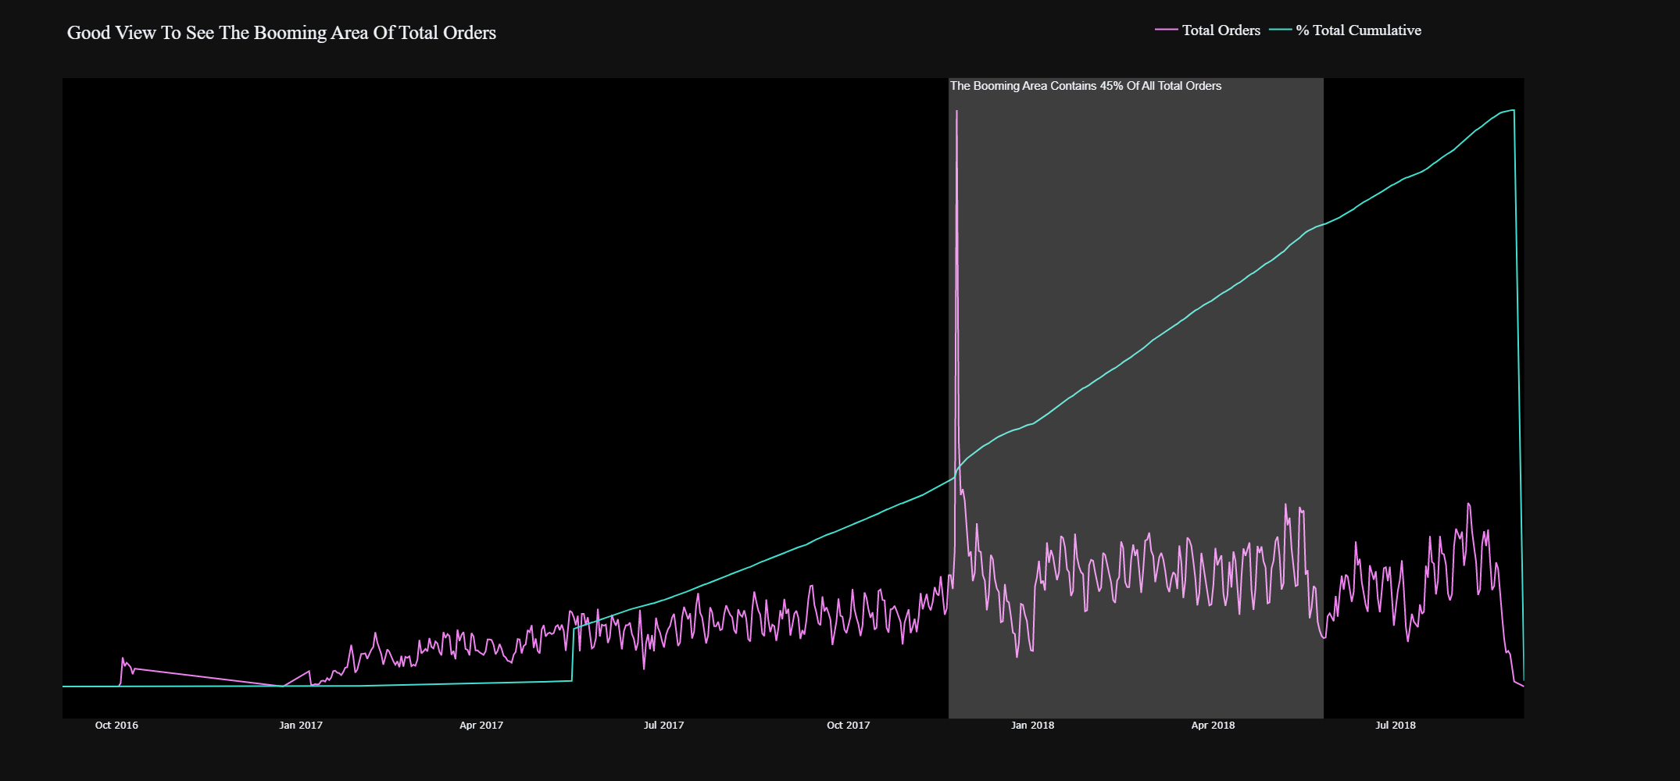
When was the booming period of total orders?
To see interactivity Q6.html

Slide 30
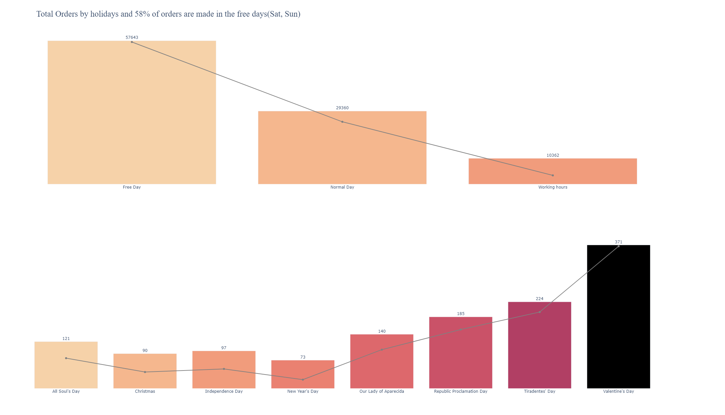
Are the holidays days affect the number of orders and what is the peak point?
To see interactivity Q8.html

Slide 31

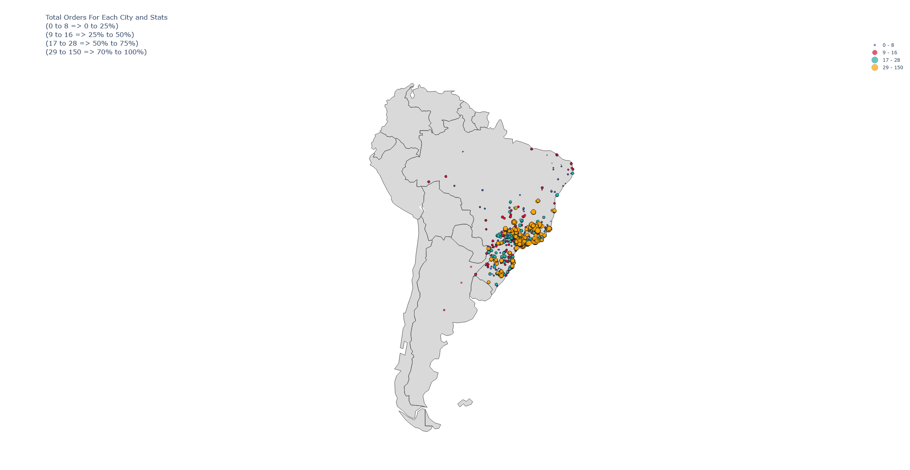
How many orders of each city and state and which are the highest ones?
Insights
The highest city that has total orders it's Sao Paulo
Sao Paulo has the highest number of total orders between 0 and 28 (75% to 100%)
There are VIP customers in it's Rio de Janeiro, which has total orders ranging from 29 to 150 (0 % to 75 %)
To see interactivity Q9.html

Slide 32
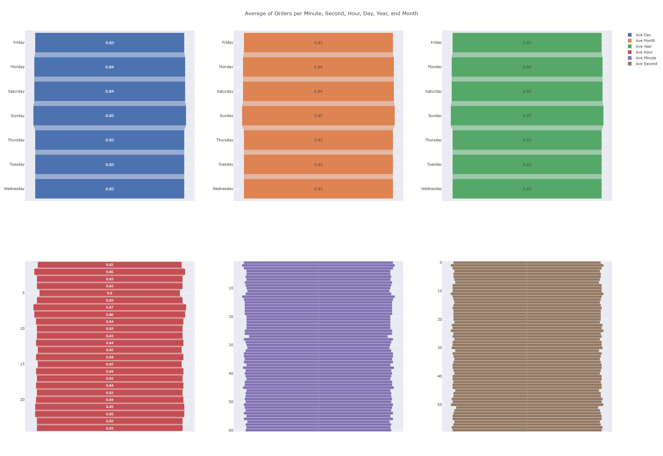
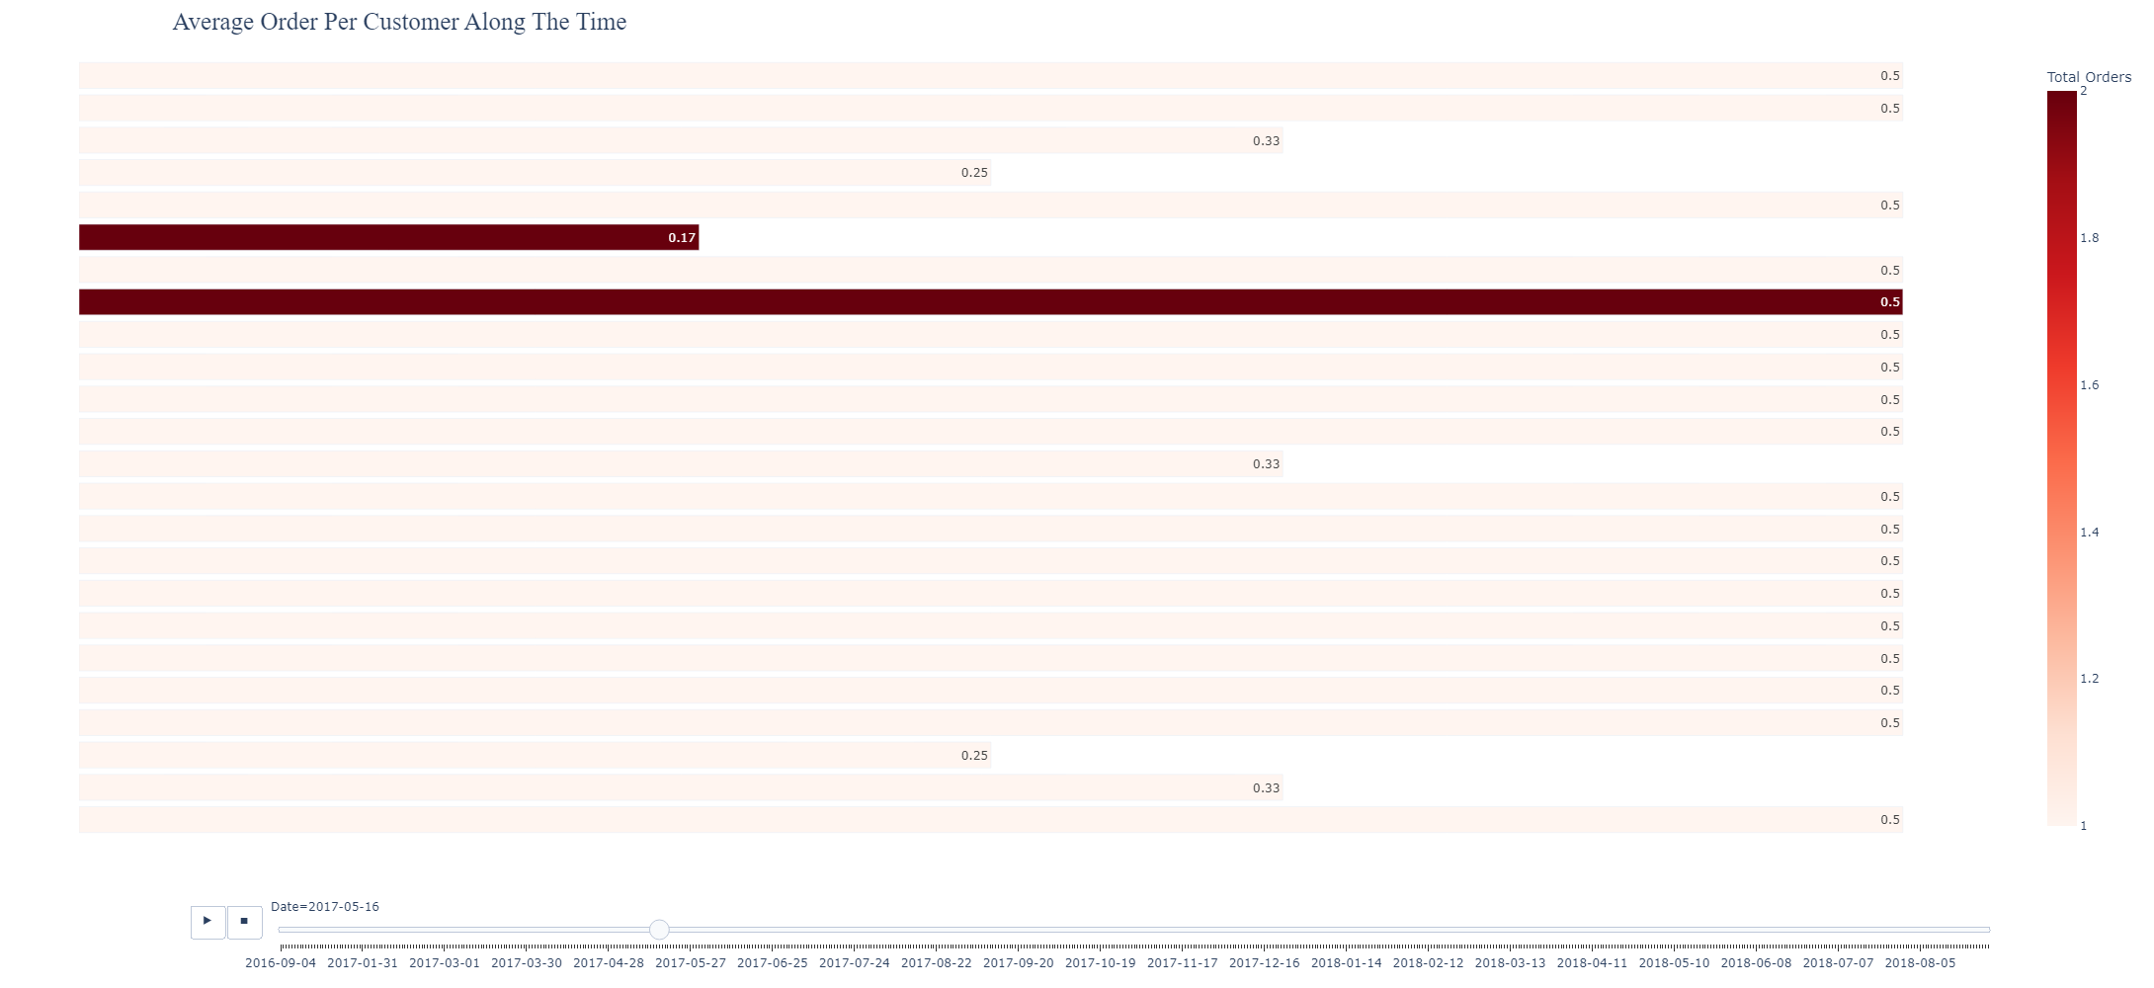
What are the Average orders per customer along the time?
What is the average order per minute, second, hour, day, year, and month?
To see interactivity Q7.html
To see interactivity Q10.html

Slide 33
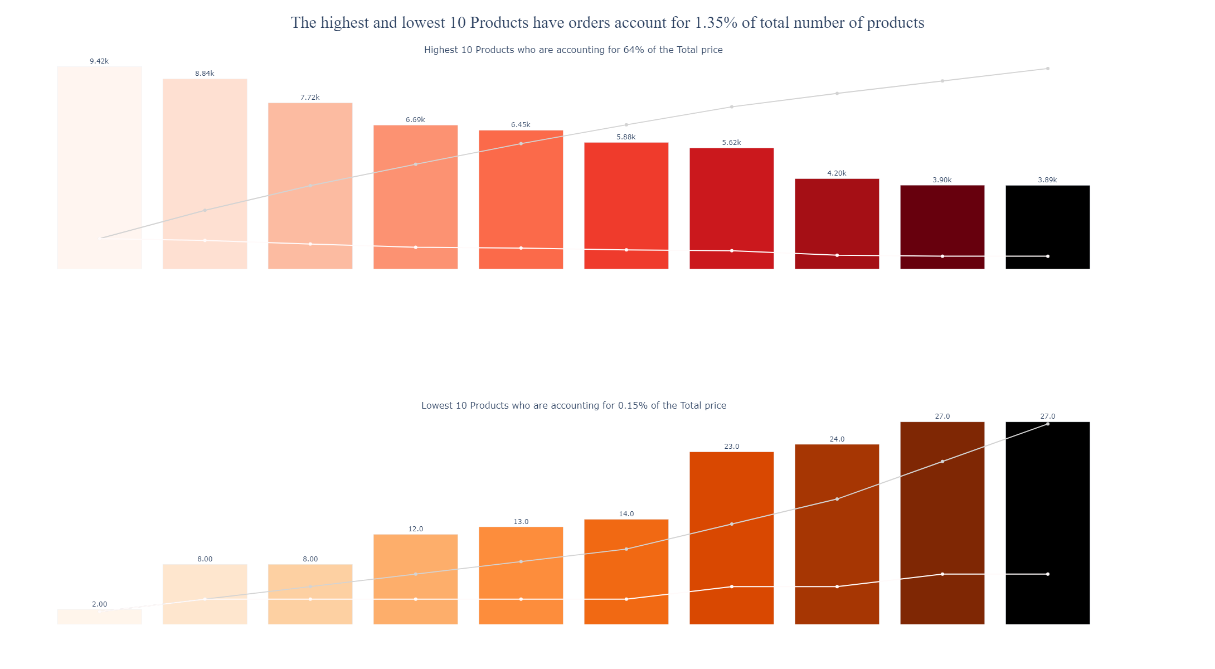
What are the highest and lowest products by total orders?
To see interactivity Q11.html
Insights
Total Orders for top 10 products 62,601 orders accounting for 64% of all total orders
Total Orders for lowest 10 products 152 orders accounting for 0.15% of all total orders
The highest and lowest products of total orders are not necessarily the highest and lowest in the total price
The highest and lowest 10 Products have orders account for 1.3 of total number of products

Slide 34

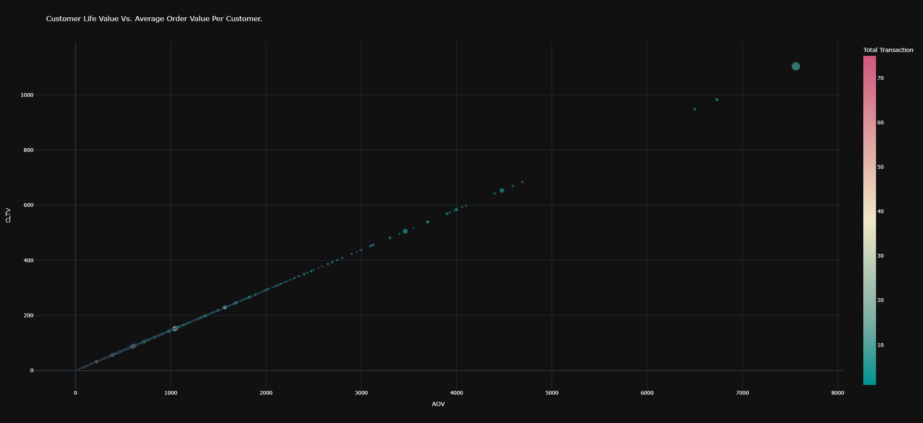
Insights
What are the customer lifetime value and average order value for each customer?
To see interactivity Q13.html
The customers who have the highest value of CLV and AOV do not necessarily have the highest values in the total transaction and total revenue
Purchase frequency of total transaction for total customers 1.23
The repeat rate for customers who purchase more than once is 0.15
AOV :
Average 132
standard deviation 198
min 1
25% 45
50% 84
75% 148
max 7560
Sure, there is a correlation between CLV and AOV

Slide 35
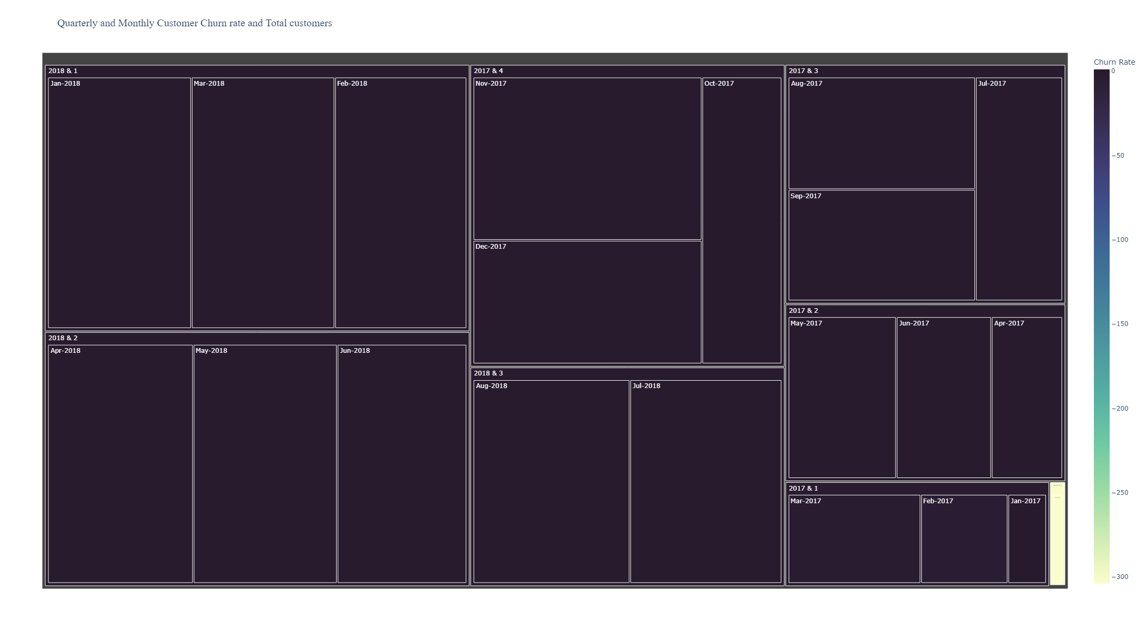
Insights
What is the churn rate of customers quarterly and monthly?
To see interactivity Q14.html
The greatest Churn rate in 2018 Sep is 0.99 and that was negative
The lowest Churn rate in 2016 Oct is -304 and that was positive
The maximum period for staying positive was three months in a row

Slide 36
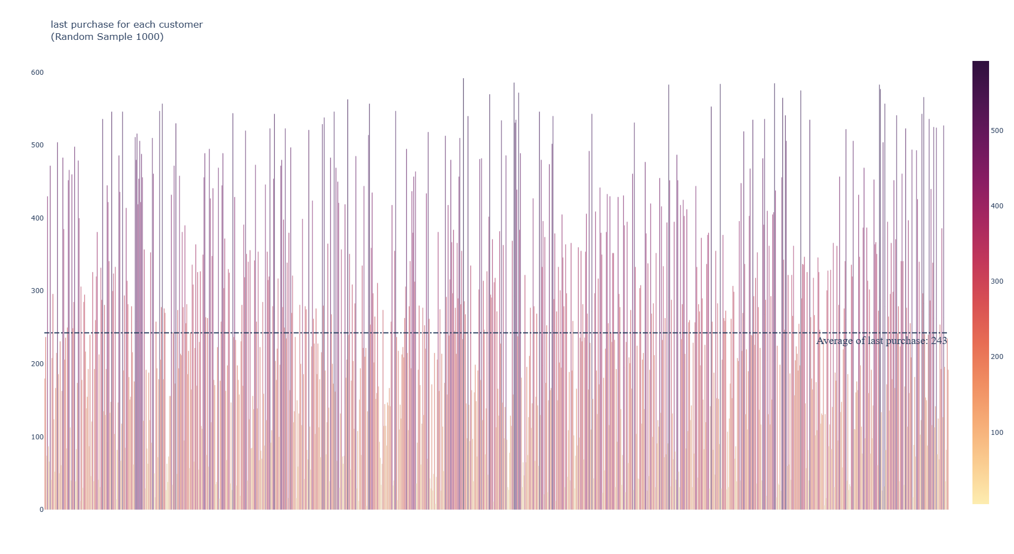

What is the last purchase process by days for each customer and what's the total average?
To see interactivity Q15.html
Insights
Last Purchase:
Average 243
Standard deviation 153
25% 118
50% 223
75% 352
Min 0
Max 728

Slide 37

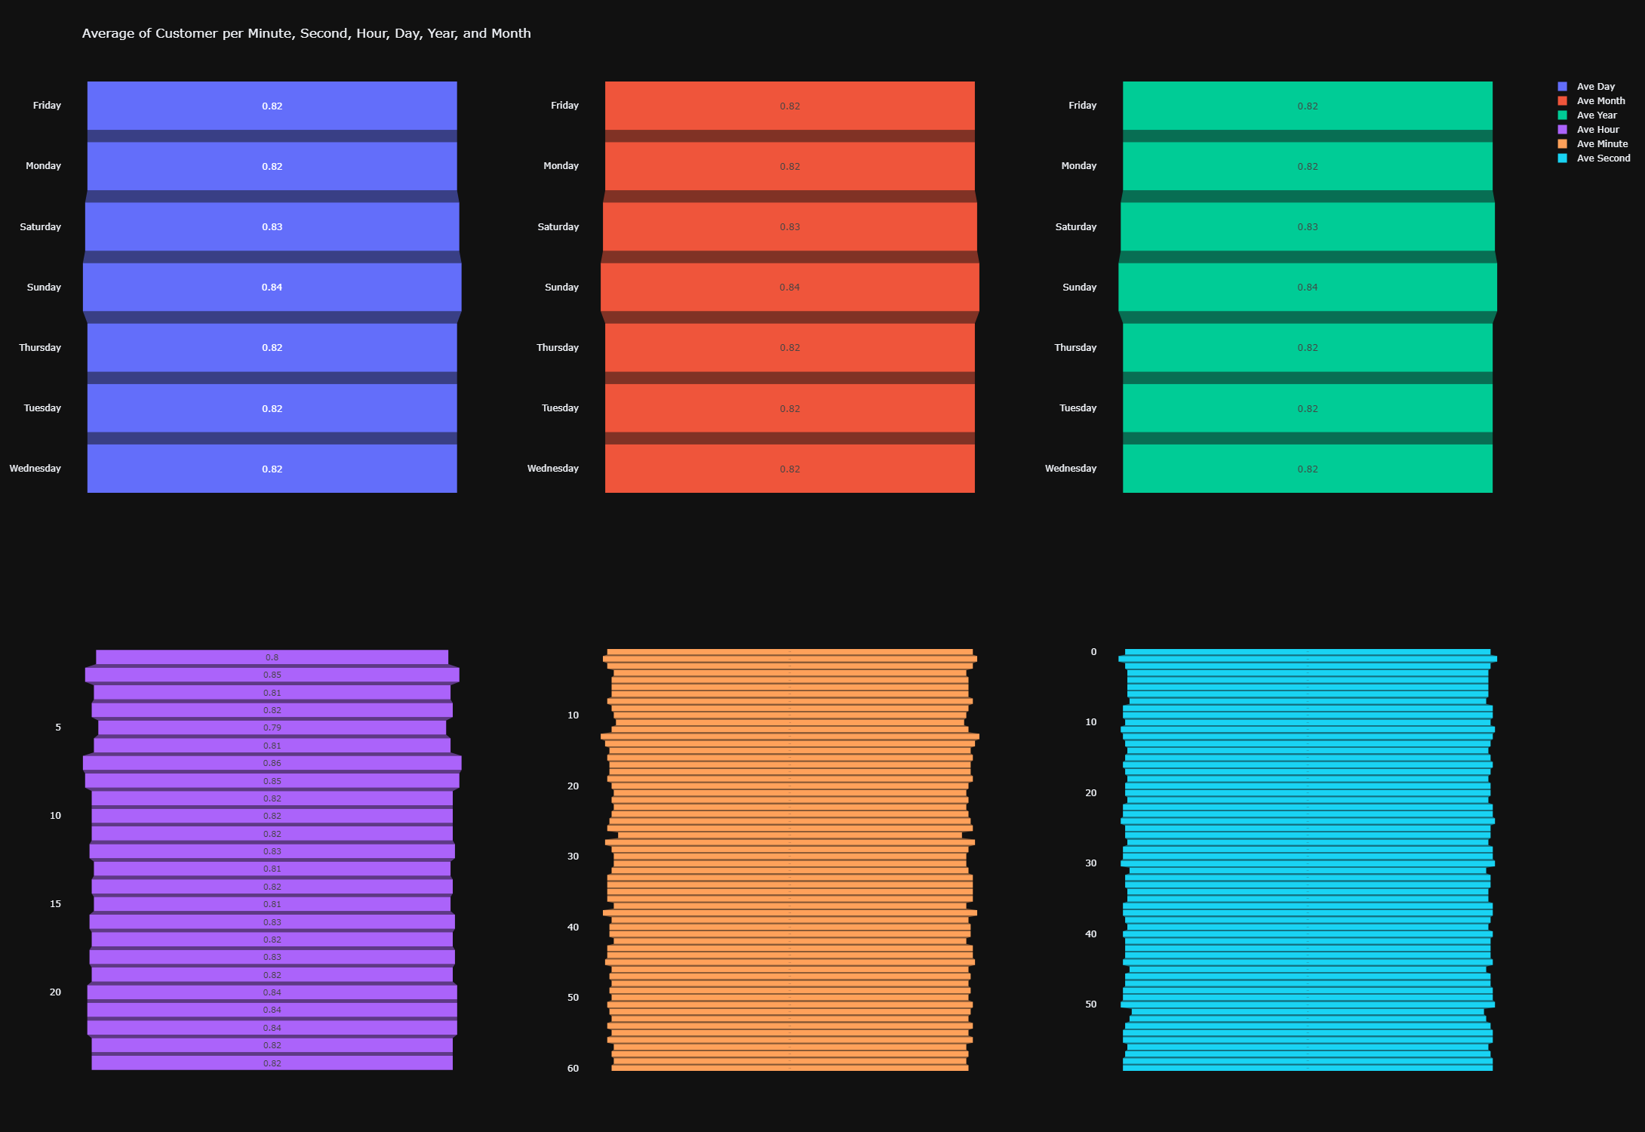
Who are the active and inactive customers?
What is the average customer per minute, hour, day, and month?
To see interactivity Q17.html
To see interactivity Q20.html

Slide 38
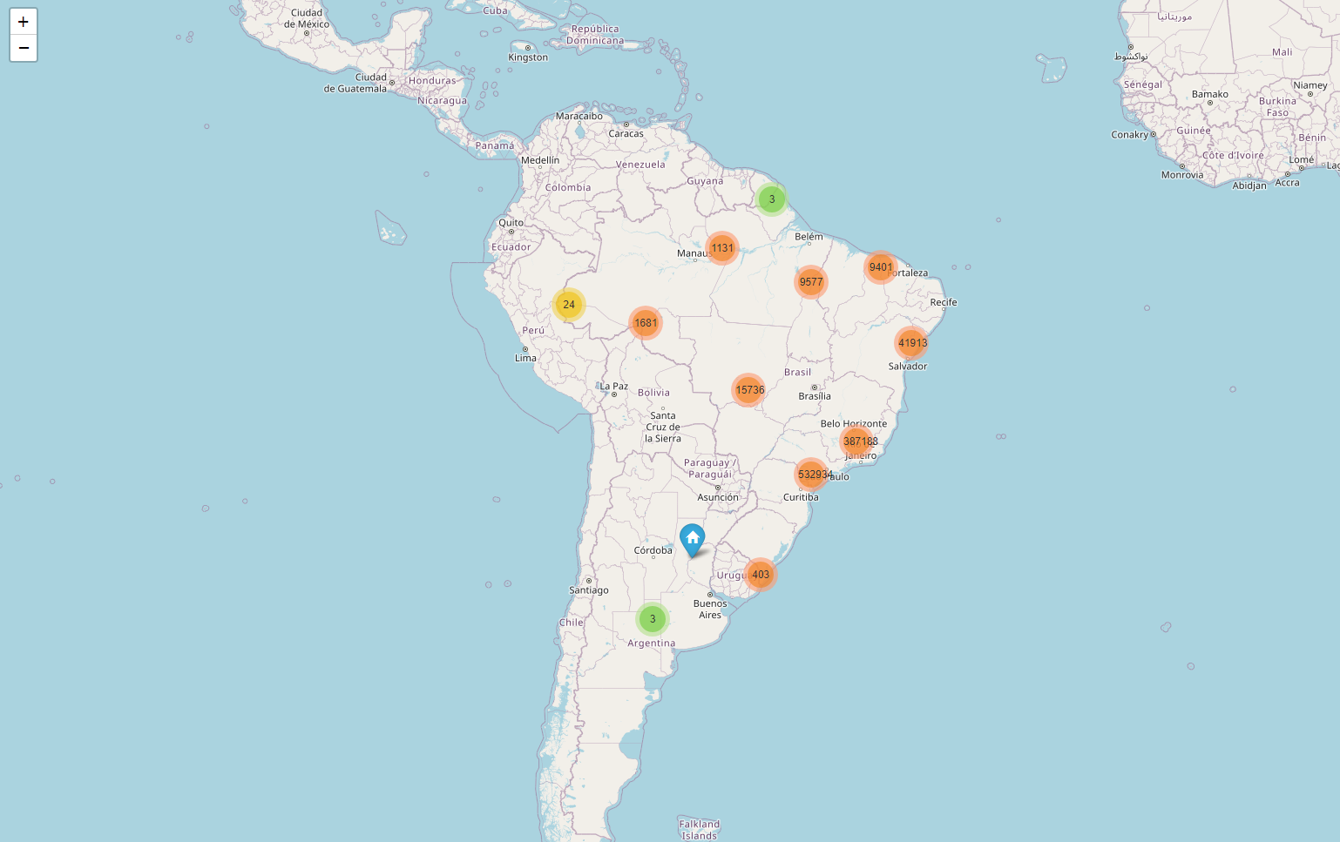
Good view to see the distribution of total customers clustering by Lat and Lag
To see interactivity Q18.html
Insights
Most customers come from the left side of the country
Most customers come from Salvador, Sao Paulo, Rio de Janeiro
Customers demand from the left side because most population lives there
Sample 1,000,000 of population 9,755,402

Slide 39
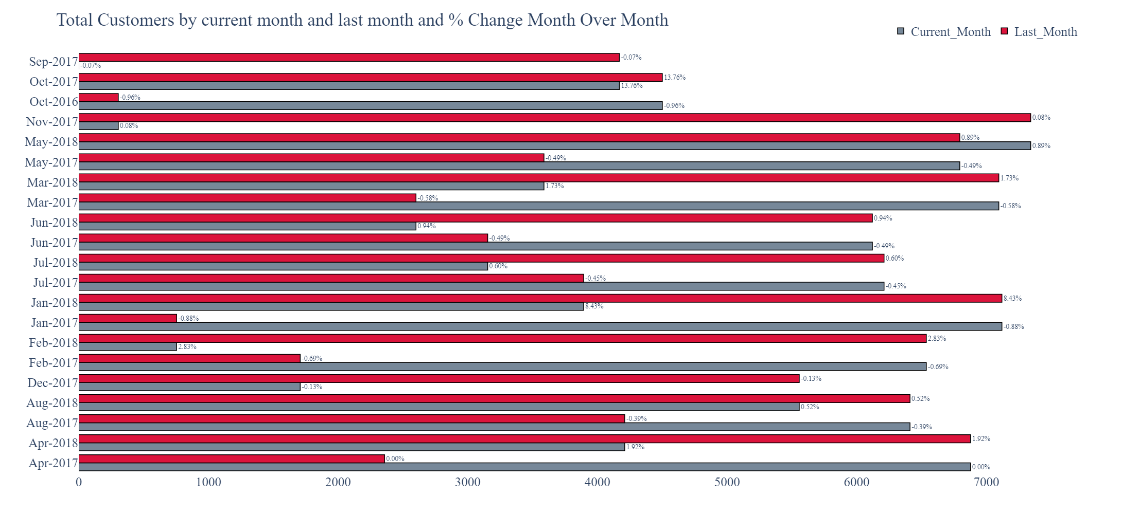
What is the total orders and the total customer month over month?
To see interactivity Q19.html
Insights
May 2018 is the most month has customers 7342
Oct 2017 is the most monthly % change from last month is 13.76%
Dec 2016, Sep 2016, and Sep 2018 have the lowest total customers, and it 5 customers for a total of the three months
10 times, the monthly % change to negative

Slide 40
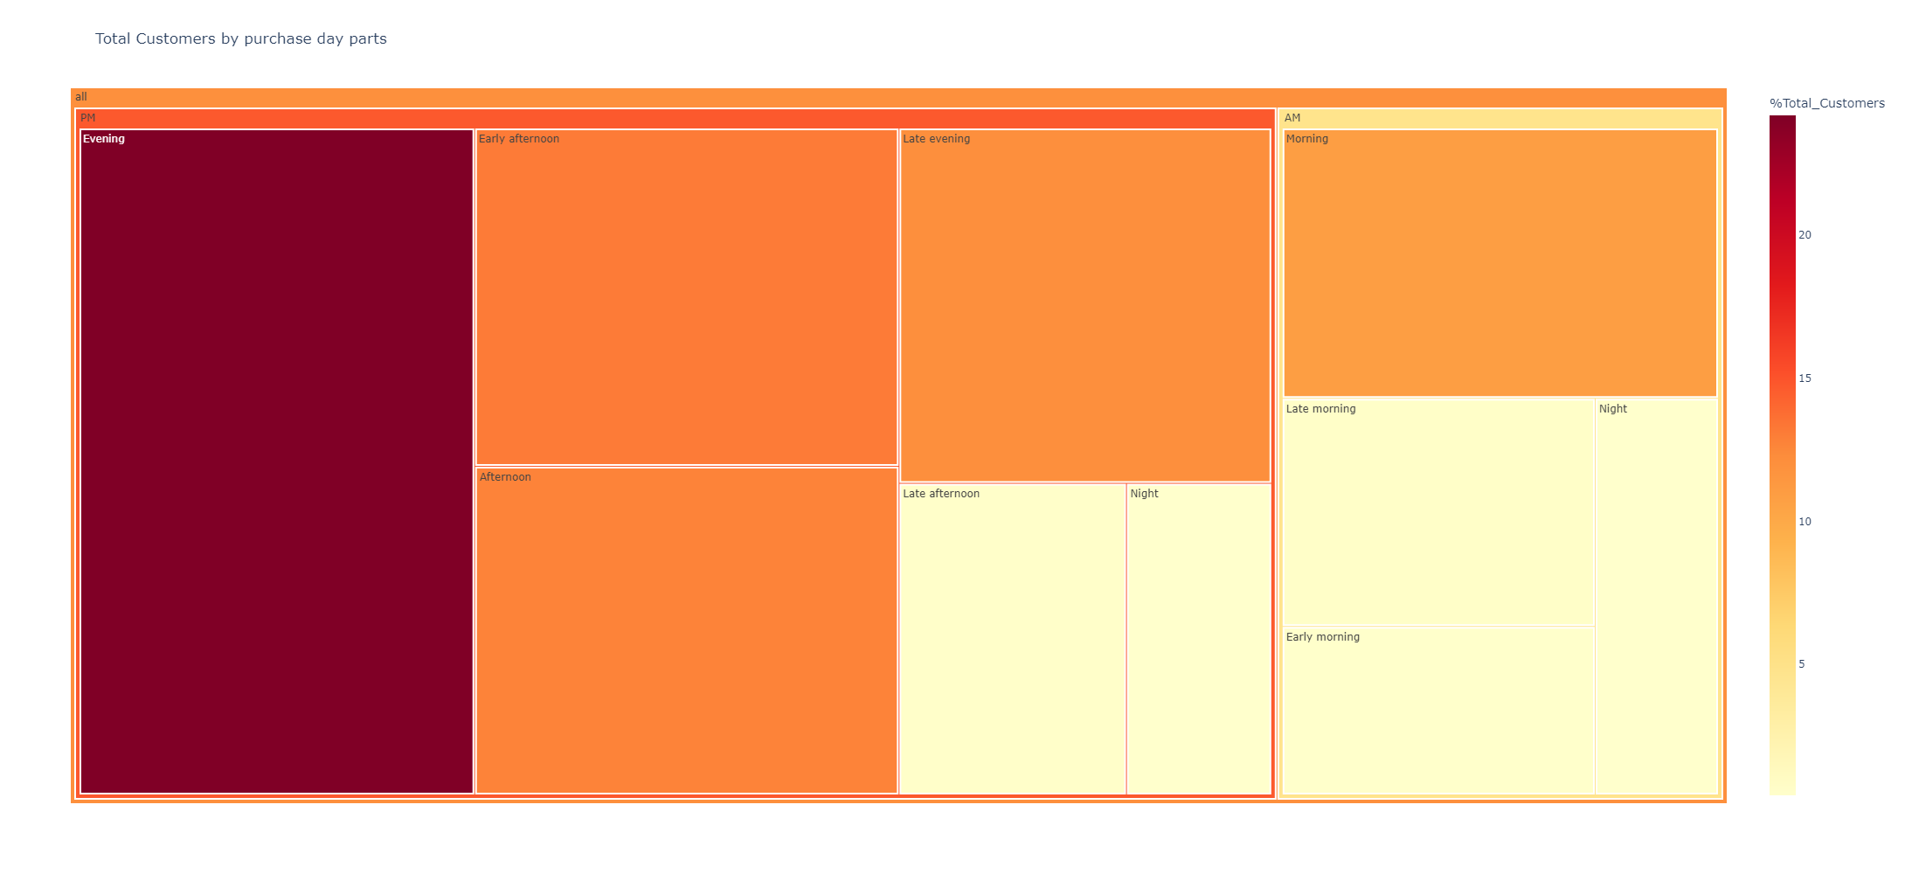
Which part of the day has the highest number of total customers?
To see interactivity Q21.html
Insights
The highest number of total orders is in the Evening 23,530k
Customers mostly come at night 70,934 (72%) than morning 26,338 (27%)
62% of total customers in ["Evening", "Early afternoon", "Afternoon", "Late evening"]

Slide 41
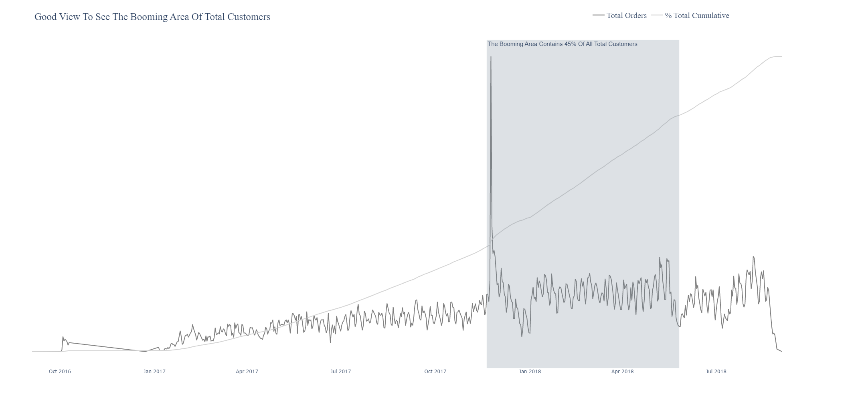
When was the booming period of total orders?
To see interactivity Q22.html

Slide 42
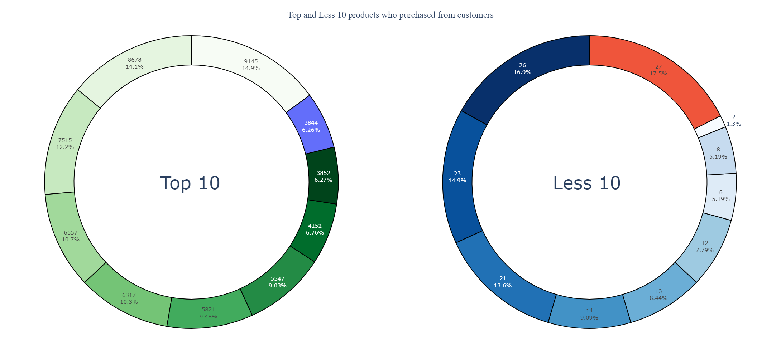
Is there a particular product that buying from customers?
To see interactivity Q24.html

Slide 43
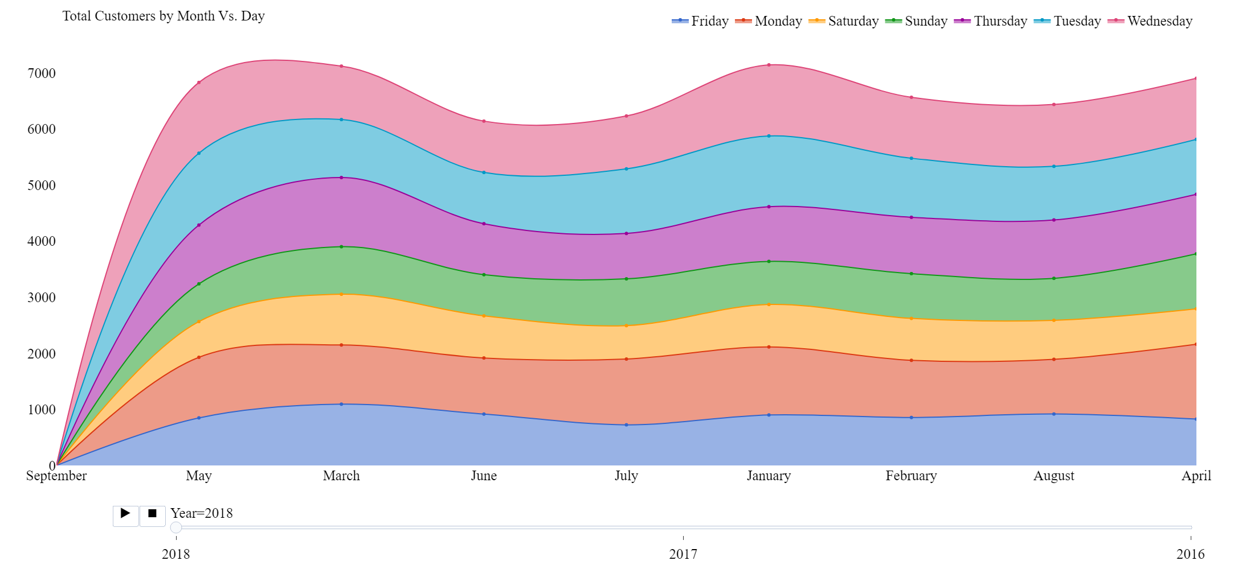
What is the total customers by month and day?
To see interactivity Q25.html

Slide 44
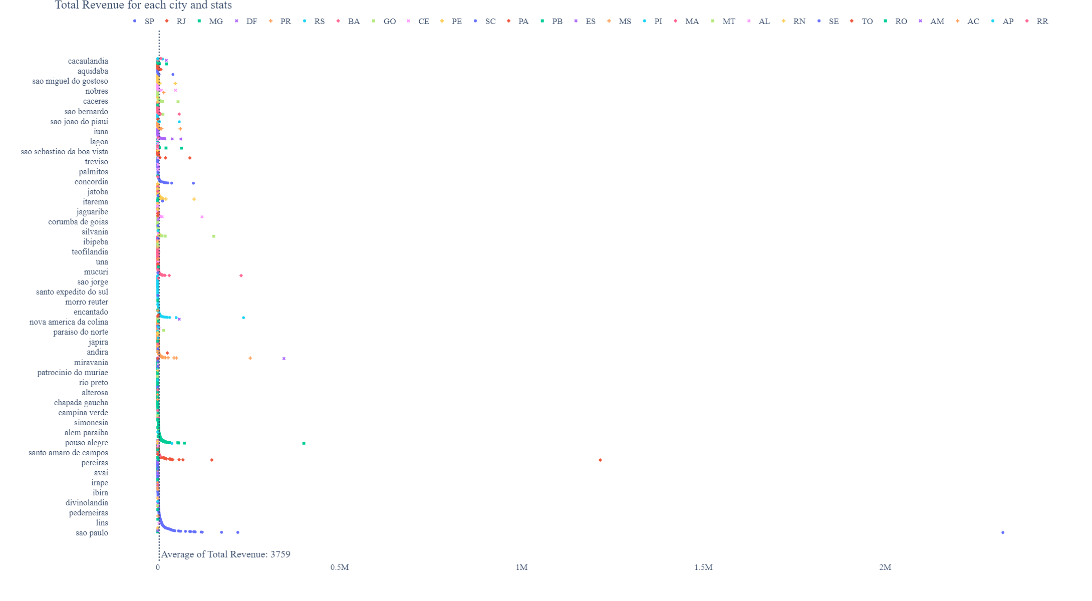
What are the most profitable cities and state?
To see interactivity Q25.html

Slide 45
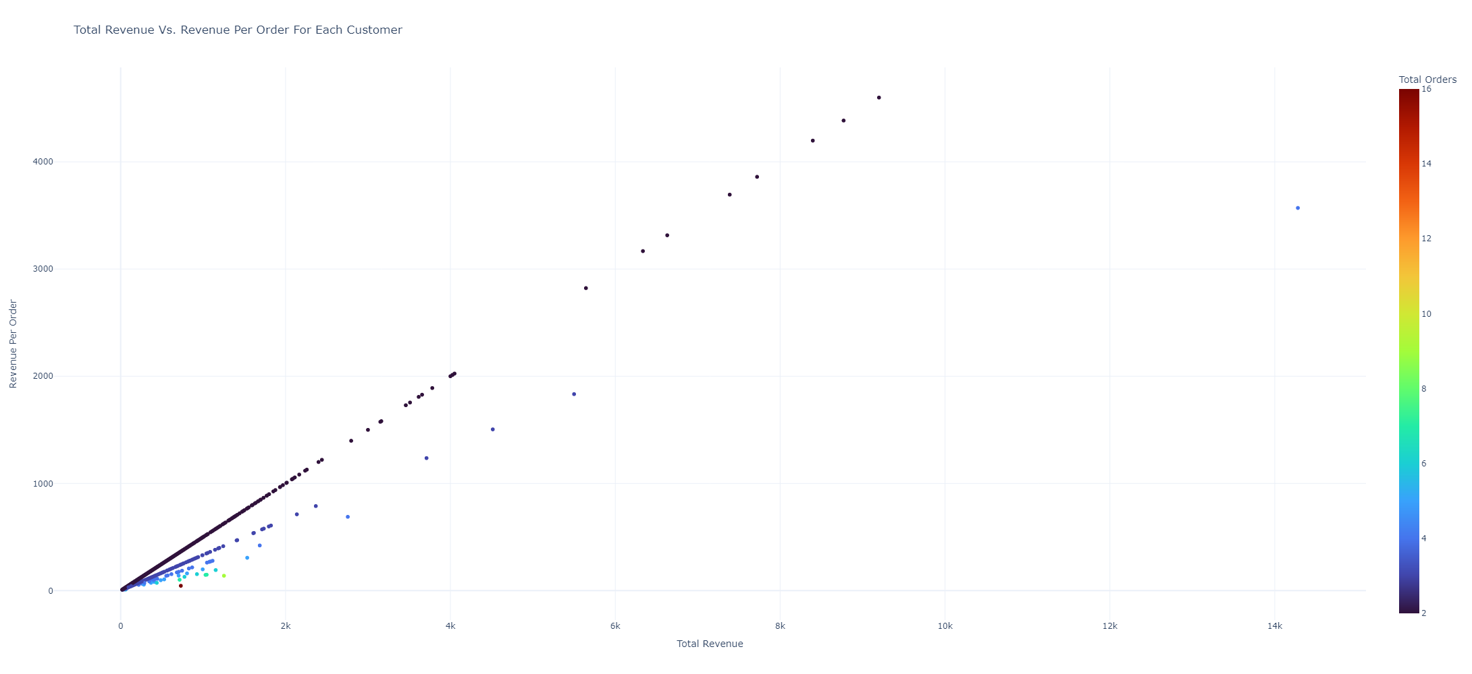
What is the total revenue per customer and orders?
To see interactivity Q27.html

Slide 46
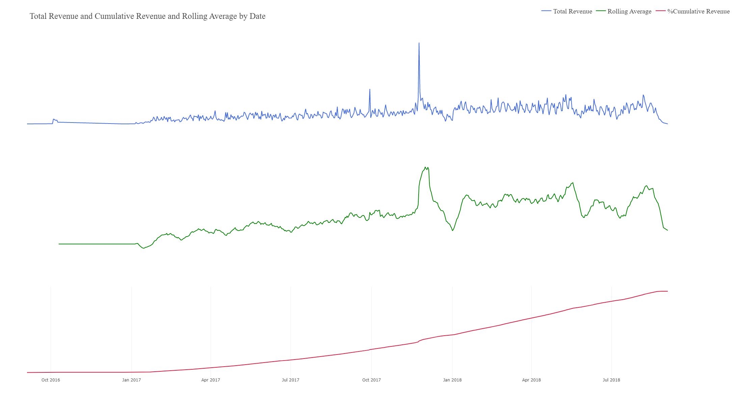
Where were the peak trends of total revenue?
what are the total cumulative revenue and rolling average of revenue?
Insights
From 2018 Jan 17 to 2018 Sep 3 accounting for 50% to 100% of all Total revenue
From 2017 Nov 11 to 2018 May 24 accounting for 45% of all Total revenue
From 2017 Dec 5 to 2018 Jan 1 there was a significant decline
From the beginning till 2017 Jan 17 accounting for 50% of all Total revenue
To see interactivity Q29.html

Slide 47
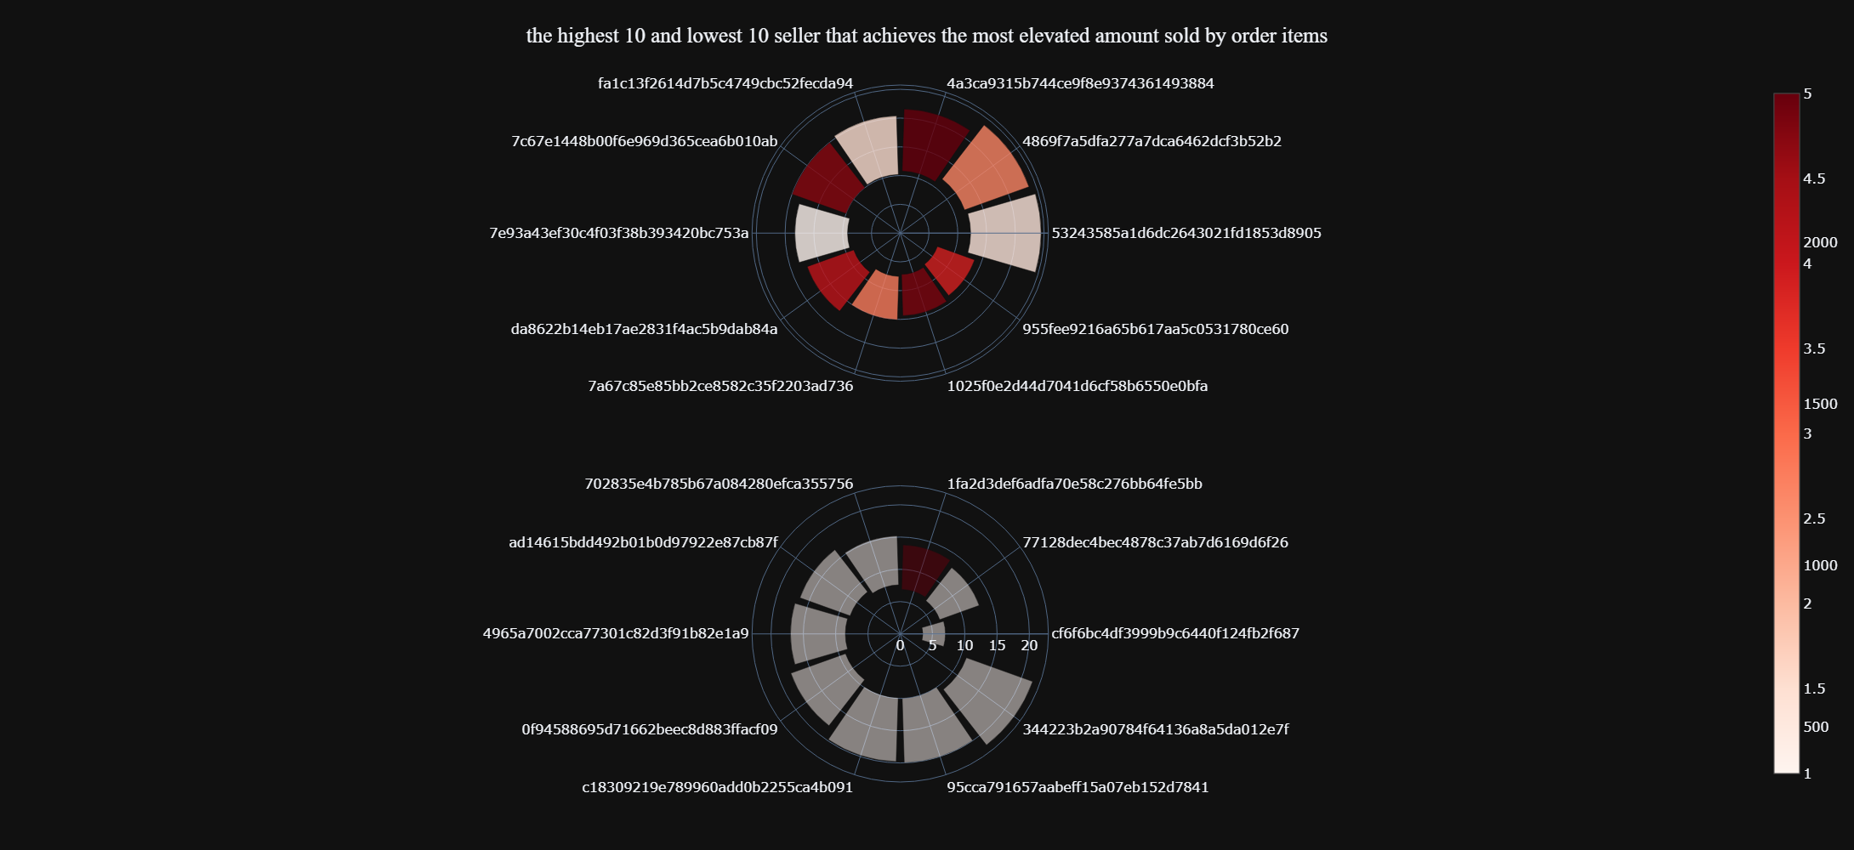
Insights
Who are the highest 10 and lowest 10 seller that achieves the most elevated amount sold by order items?
To see interactivity Q30.html
Top 10 sellers accounting for 0.003 of all number of sellers, 13% of all the amount sold, and 10% of all the order items
The highest amount sold is not necessarily the highest total of order items for example the highest seller has a total amount sold of 244,627 and a total of order items of 532 although there is a seller who has a total of order items of 2,374 and total amount sold of 143,675
143,6757e93a43ef30c4f03f38b393420bc753a This seller has the most average price per order item 512 a total amount sold of 182,878, and the total order items 357

Slide 48
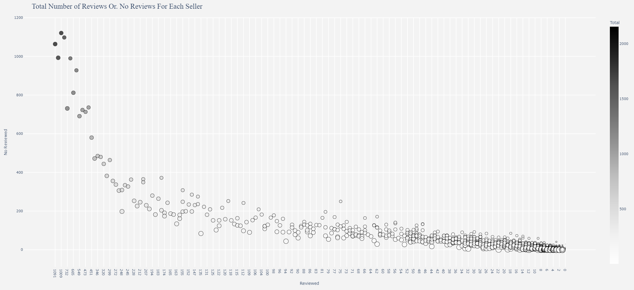
Who is the highest seller whose orders have reviews?
To see interactivity Q31.html

Slide 49

What is the average purchase approval time, and does it affects repurchase or order status, what is the most frequent time?
To see interactivity Q32.html
When the customer repurchase for 29 times the average time approval by the day is 2 days
When the customer repurchase for 16 times the average time approval by the minute is 53 minutes
When the customer repurchase for 22 times the average time approval by the hour is 23 hours
Average time approval by the day is 2 days, by the hour is 10 hours, and by the minute is 15 minutes
Most frequently the time approval is in minutes

Slide 50

What is the average purchase approval time, and does it affects repurchase or order status, what is the most frequent time?
To see interactivity Q33.html
When the customer repurchase for 26 times the average time approval by the day is 9 days
When the customer repurchase for 2 times the average time approval by the minute is 0.1 minutes
When the customer repurchase for 16 times the average time approval by the hour is 9 hours
Average time approval by the day is 3 days, by the hour is 14 hours, by the seconds is 40 seconds, and by the minute is 32 minutes
Most frequently the time approval is in days 78823

Slide 51


Does the delivery time impact repurchase or reviews?
To see interactivity Q34.html
There's a negative correlation of -0.35 between delivery time by days and the # of repurchases(If the days decreased then the # repurchases increased)
There's a negative correlation of -0.16 between delivery time by days and the # of Reviews(If the days decreased then the # Reviews increased)
There's a negative correlation of -0.15 between delivery time by days and the # of No Reviews(If the days decreased then the # No Reviews increased)

Slide 52

What is the average delivery time for each order and the most frequent time?
To see interactivity Q35.html

Slide 53

Are the orders reaching at the estimated time and what is the most frequent time?
To see interactivity Q36.html

Slide 54


Does the review answer time influence delivery time and what is the average and most frequent time?
To see interactivity Q37.html
There's a negative correlation of -0.51 between delivery time by days and the # of reviewed(If the days decreased then the # reviewed increased)
There's a negative correlation of -0.5 between delivery time by days and the # of No Reviews(If the days decreased then the # No Reviews increased)

Slide 55


Does the shipping limit time deliver influence delivery time and what is the average and most frequent time?
There's a negative correlation of -0.2 between delivery time by days and shipping time (If shipping time decreased then delivery time increased)
To see interactivity Q38.html

Slide 56

What are the price quantiles for each city and state?
To see interactivity Q39.html

Slide 57

What is the total payment value for each payment type and payment sequential?
To see interactivity Q40.html

Slide 58

What is the total payment value for each payment type and payment sequential?
To see interactivity Q41.html

Slide 59

What are the highest installments by the payment value and total transactions?
To see interactivity Q44.html

Slide 60


Analysis of the worst score reviews and figure out why?
23% of people who haven't made a review of worst scores less than 3 score
It's abnormal for the average delivery time of 16 days while the average delivery overall is 10 days
 | delivery_number
count | 17014.0
mean | 17.0
std | 15.0
min | 1.0
25% | 6.0
50% | 12.0
75% | 24.0
max | 195.0
let's see if estimated time delivery and delivery time have an impact on the reviews score overall by days
There's a negative correlation of -0.27 between delivery time by days and the reviews score(If the days decreased then the reviews score increased)
16% of reviews that took less than 3 scores of all reviews
25% of worst score orders didn't arrive at the estimated time under -2 days
 | estimated_numbr
count | 16817.0
mean | 5.0
std | 14.0
min | -189.0
25% | -2.0
50% | 7.0
75% | 14.0
max | 68.0
let's see if estimated time delivery and delivery time have an impact on review score but here only the worst scores with less than 3 score
There’s no compelling correlation here

Slide 61

Are there people taking installments at a particular time?
To see interactivity Q45.html

Slide 62




How many customers don't make a review and why?
58% of all orders haven't made reviews 68628
There's a positive correlation of 0.22 between the estimated time of delivery and # of reviews (If the estimated time increased then the # of reviews also increased)
There's a negative correlation of -0.55 between delivery time and # of reviews (If delivery time decreased then # of reviews increased)

Slide 63

What is the highest review's title and comments?
To see interactivity Q47.html

Slide 64

What are the quarterly, monthly, daily, and hourly for freight value?
To see interactivity Q48.html

Slide 65

What are the minute and seconds for total revenue and total transactions?
To see interactivity Q49.html

